Slide 1
Master Thesis 7th December 2021
Using Neural Networks for the Domain Adaptation of Synthetic Generated Document Images
Contact:
Giriraj Sukumar Pawar
Email: giriraj.pawar2012@gmail.com
Matriculation Number: 551205
Master in Embedded Systems
Advisors: Prof. Dr.-Ing. Gangolf Hirtz, Dr.-Ing. Ana Cecilia Perez Grassi and M.Sc. Tobias Scheck
Dr.-Ing. Martin Voigt and Paul Fischer (elevait GmbH & Co. KG, Dresden)

Slide 2
Master Thesis Using Neural Networks for the Domain Adaptation of Synthetic Generated Document Images
Problems in Deep Learning
Scarcity of data.
Data labeling is tedious and costly job.
Often ML engineers create synthetic data.
Models trained with synthetic data will not generalize well to real data because of domain gap.
Image-to-image translation is challenging in the absence of paired training data.
Notes:
Before diving into the actual thesis topic, discuss problems in deep learning.
To train any neural network, requires a large amount of data to generalize well in the real world, but there is a huge scarcity of data.
Even somehow data is collected, labelling it manually difficult and costly job.
Hence, often Machine learning engineers create synthetic data, but if you train a model using synthetic data then model will not perform well in the real world upon exposed to real data. Because of the domain gap.
Over the years, several domain adaptation methodologies have been developed, Image-to-Image translation is one of them, In which image is transformed from one domain to other domain. And Image-to-Image translation is very challenging in the absence of paired training dataset.
Now lets have look into some examples of Image-to-image translation.

Slide 3
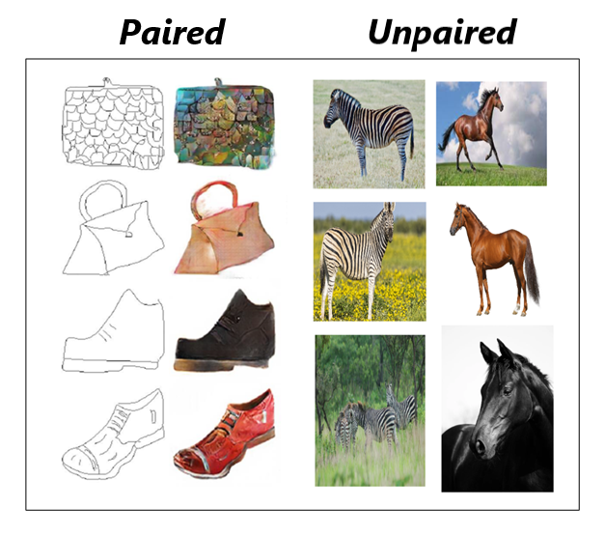
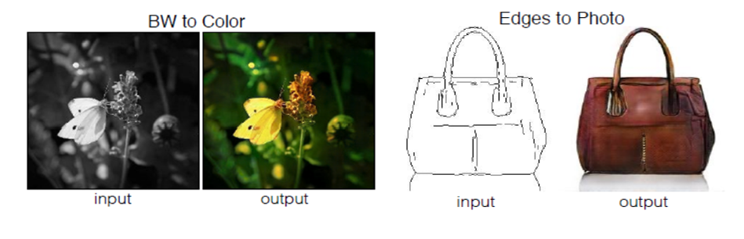
Master Thesis Using Neural Networks for the Domain Adaptation of Synthetic Generated Document Images
Examples of Image-to-Image Translation
Figure 1: Examples of Image-to-image translation [2].
Figure 2: Paired and unpaired training dataset example [2].
Notes:
First example is transforming black and white image into a colour image. Next, an edge image transformed into actual object.
Next, is the example of paired training dataset, in paired training dataset there is correspondence between source image and target image and in unpaired training dataset, as we can see first training samples in both domains do not match.
In thesis we have implemented an unpaired image-to-image translation application using CycleGAN and full form of CycleGAN is Cycle-Consistent Adversarial Network. It is one of the improved and modified version of Generative Adversarial Networks in short GANs.
Before discussing CycleGAN, let us see How GANs work.

Slide 4
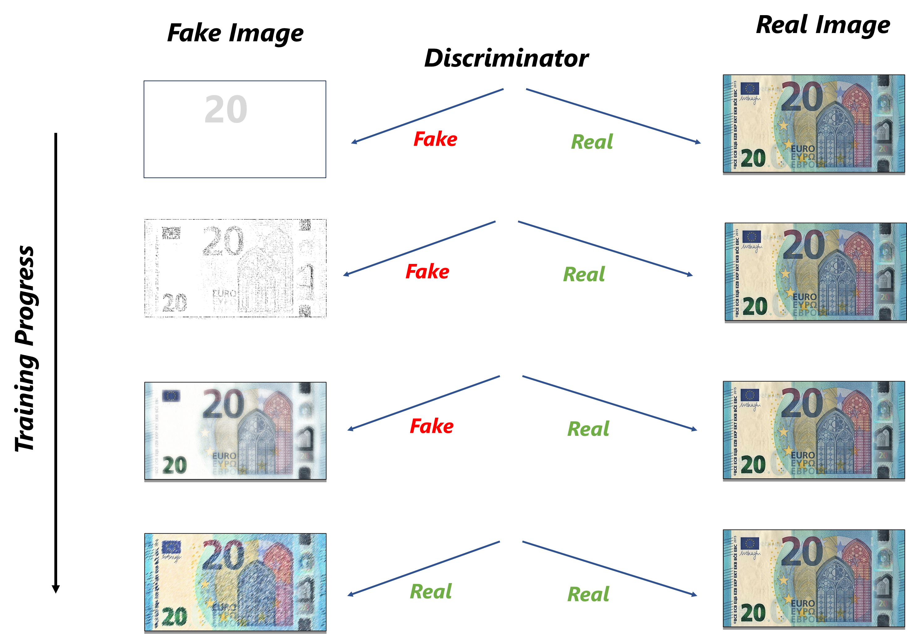
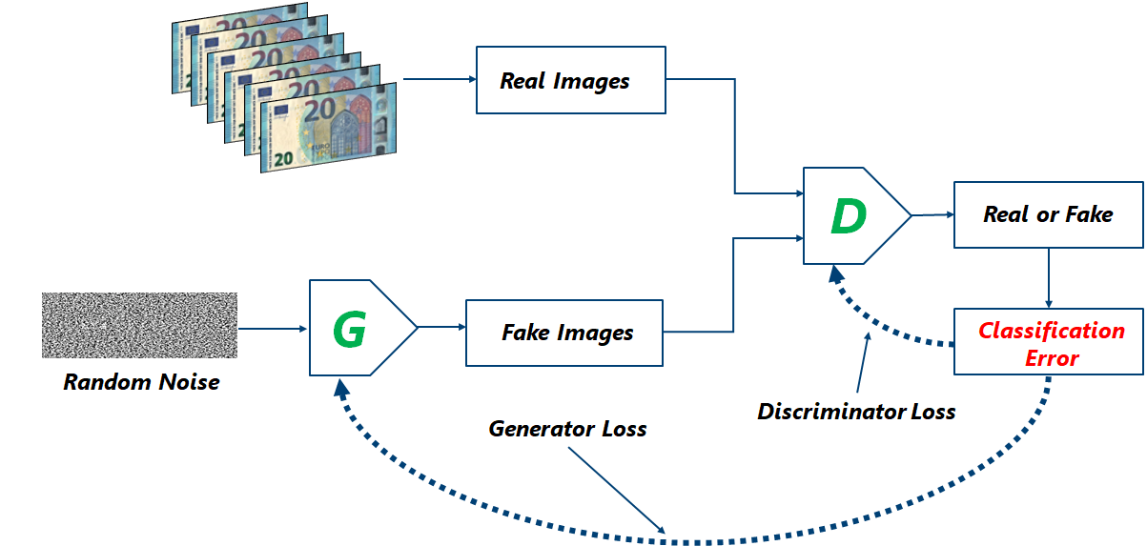
Master Thesis Using Neural Networks for the Domain Adaptation of Synthetic Generated Document Images
GANs (Generative Adversarial Networks)
Figure 3: Overview of GANs with generator and discriminator inputs, outputs and their interactions.
Figure 4: Intuitive example of GANs training.
Notes:
GANs have two important components, First is Generator and second is Discriminator, and Both are neural networks.
In general GAN, Generator produces fake images from the random noise, if discriminator finds the generated image is fake, then it provides the feedback to Generator to update itself.
Simultaneously, Discriminator also learns from real images and the fake images produced from the generator, if it misclassifies an fake image as real and real image as fake, then discriminator loss is backpropagated to update the weights of itself.
Now some illustration of GANs training process, initially generator does not produce quality images, hence discriminator easily classifies them as fake, over the time, generator learns and produces quality images and discriminator starts to classify them as real.
Next, we will see what problem this thesis is attempting to address.

Slide 5
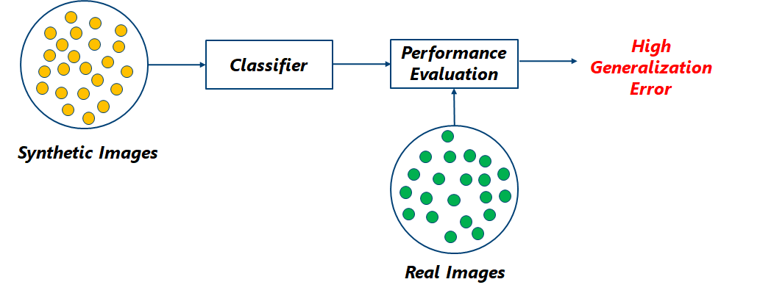
Master Thesis Using Neural Networks for the Domain Adaptation of Synthetic Generated Document Images
Problem
Figure 5: An illustration of the domain gap problem this thesis aims to solve.
Notes:
As mentioned earlier, if we train a classifier using synthetic images and later if we evaluate it using real images, generalization error is very high.
Next, In proposed solution.

Slide 6
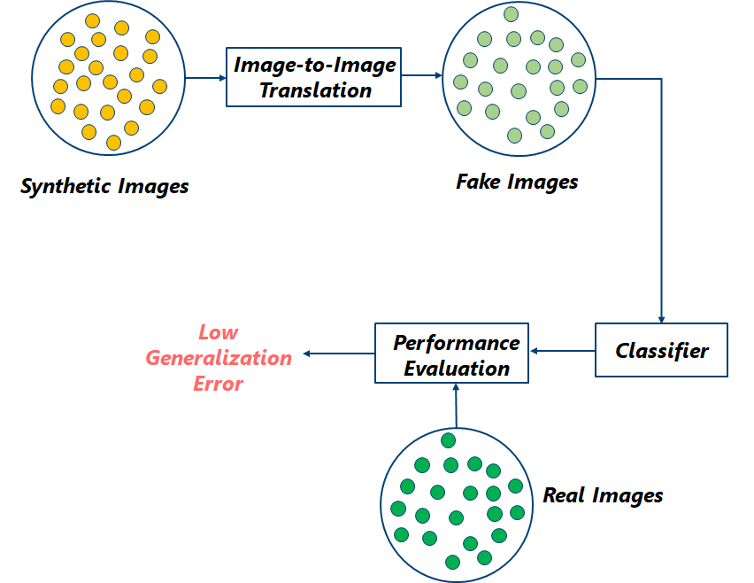
Master Thesis Using Neural Networks for the Domain Adaptation of Synthetic Generated Document Images
Proposed Solution
* Fake Images ≈ Real Images
Figure 6: An illustration of the proposed solution to reduce the domain gap between synthetic data distribution and real data distribution.
Notes:
1. We use and unpaired image-to-image translation application to transform synthetic images into fake images.
These fake images are approximately equal to the real images.
2. Then we train a classifier using these fake images and evaluate that model using real images, generalization error is low.

Slide 7
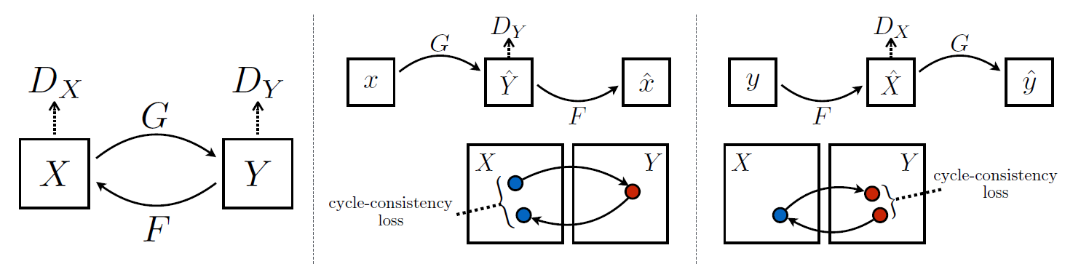
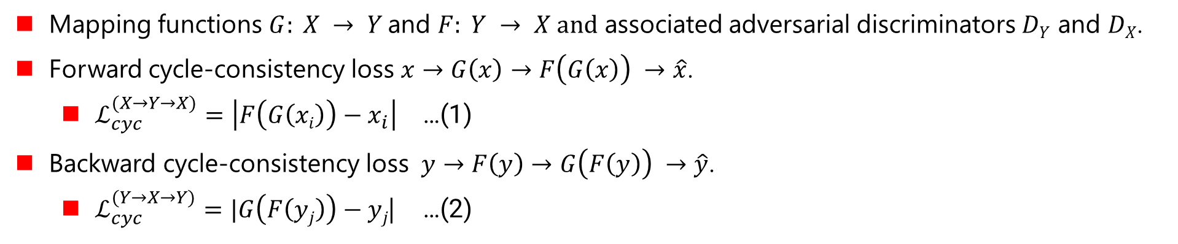
Master Thesis Using Neural Networks for the Domain Adaptation of Synthetic Generated Document Images
CycleGAN (Cycle-Consistent Adversarial Network)
Mapping functions $G: X → Y$and $F: Y → X and$ associated adversarial discriminators $DY$ and $DX$.
Forward cycle-consistency loss $x→G\left(x\right)→F\left(G\left(x\right)\right) →\hat{x}$.
$ℒ_{cyc}^{(X→Y→X)}=\left|F\left(G\left(xi\right)\right)−x_{i}\right|$ …(1)
Backward cycle-consistency loss $y→F\left(y\right)→G\left(F\left(y\right)\right) →\hat{y}$.
$ℒ_{cyc}^{(Y→X→Y)}=|G\left(F\left(yj\right)\right)−yj$| …(2)
Figure 7: Overview of CycleGAN with cycle-consistency loss[2].
Notes:
Now lets have a look into CycleGAN. It is an unpaired image-to-image translation method.
It has two generators and two discriminators. Generator G transform images from Source domain to Target Domain and Generator F transforms images from Target domain to Source domain. D_{Y} D_{X} are respective discriminator.
Cycle-consistency loss is the core loss function of CycleGAN. The “cycle consistent” property of image-to-image translation can be understood by an example of language translation, if we translate sentence from English to German, and then translate it back from German to English, we should arrive back at the original sentence.
Two type of Cycle-consistency loss one is forward and other is backward.
Forward Cycle-consistency calculated between original source image and cycled source image.
We can see in equation 1, input from source domain passed through generator G and the fake image produced by the generator G passed through generator F and mean absolute error is calculated.
Backward Cycle-consistency calculated between original target image and cycled target image.
We can see in equation 2, input from target domain passed through generator F and the fake image produced by the generator F passed through generator G and mean absolute error is calculated.

Slide 8
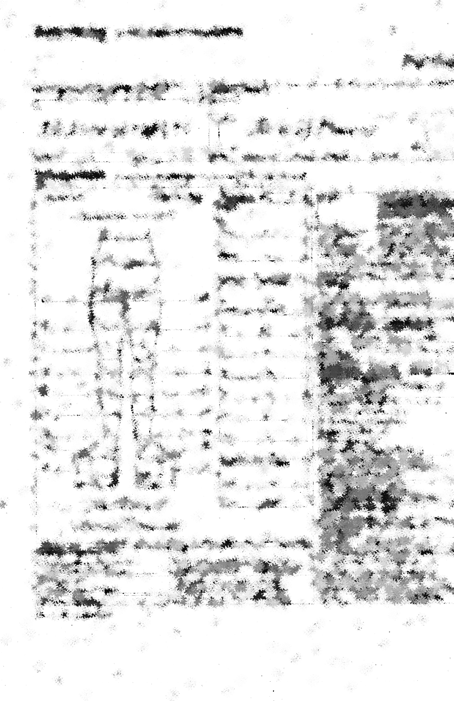
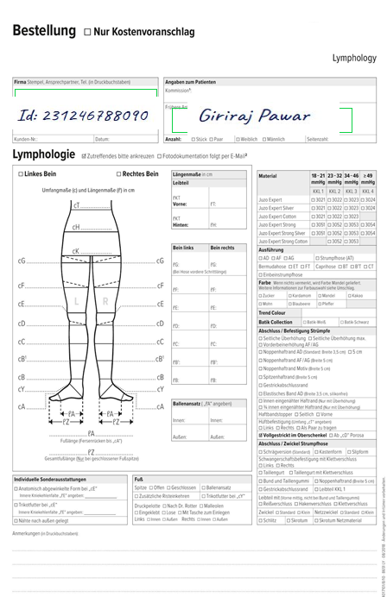
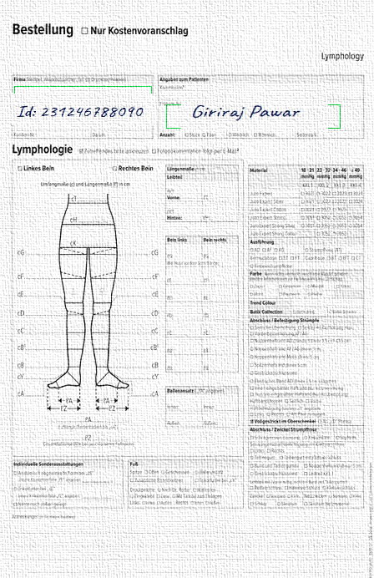
Master Thesis Using Neural Networks for the Domain Adaptation of Synthetic Generated Document Images
CycleGAN Architecture
Real
Fake
Real
Fake
Backpropagation
Backpropagation
D_{y}
D_{x}
Synthetic Image
≈ Synthetic Image
(Cycled)
G
Fake
Image
F
Forward Cycle-Consistency Loss
Figure 8: Architecture of CycleGAN with forward cycle-consistency loss.
Notes:
Now let us have a look into CycleGAN architecture. Using generator G, the synthetic image is transformed into fake image, which approximately similar to real image, then this fake image transformed back to its original form and it is called cycled-synthetic image. Now the loss between actual synthetic image and cycled synthetic image calculated to update the weights of the generator G. this loss is called forward Cycle-consistency loss.
The most important component in this architecture is Generator G, which is used to transform synthetic images into fake images, that are similar to real images, so we can close the domain gap between synthetic data distribution and real data distribution by producing large number of samples in the target domain. We will discuss about it in coming slides.

Slide 9
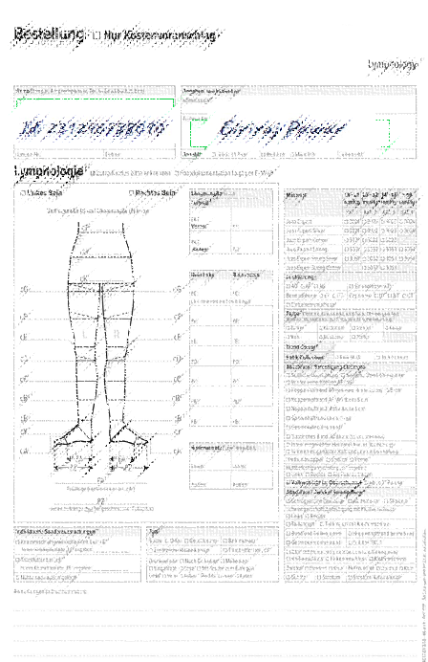
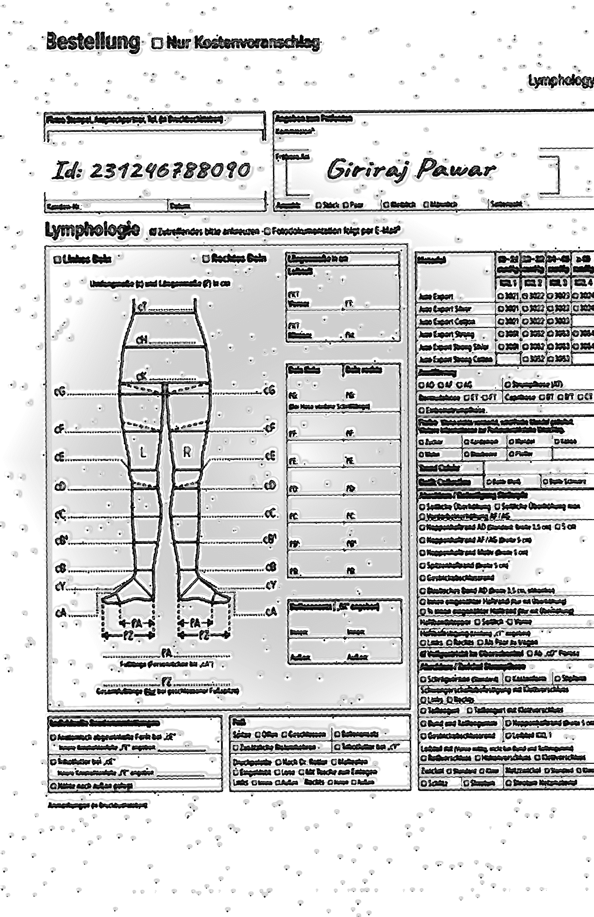
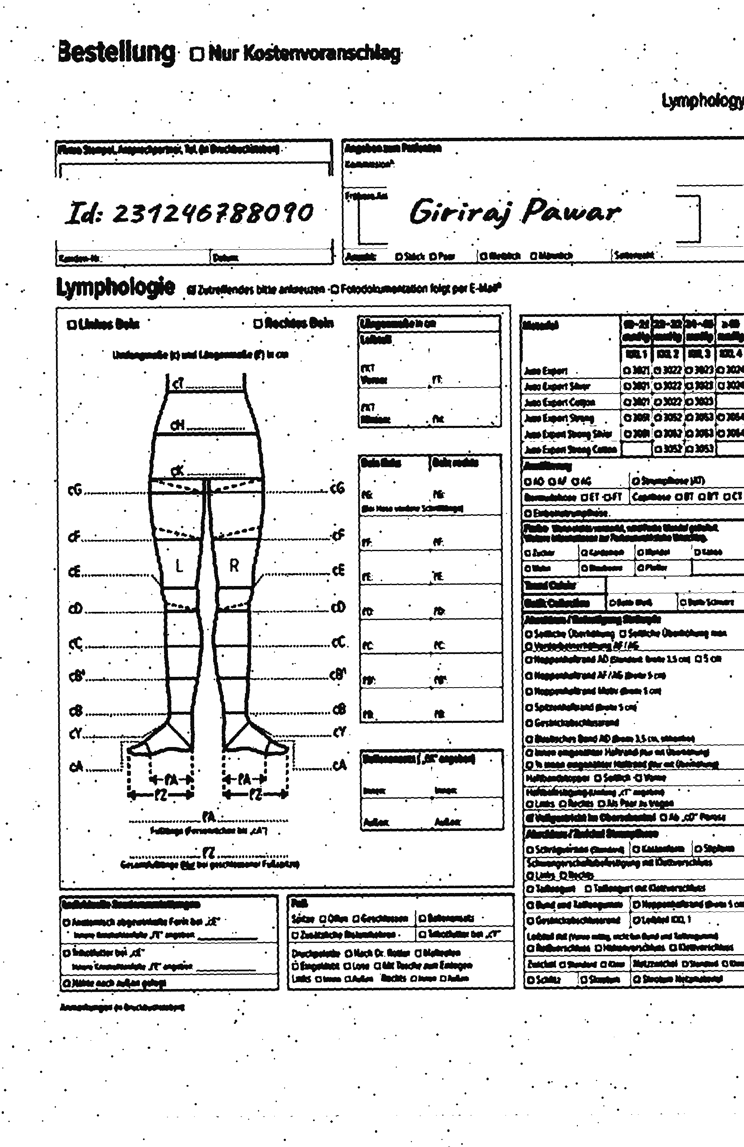
Master Thesis Using Neural Networks for the Domain Adaptation of Synthetic Generated Document Images
CycleGAN Architecture
Real
Fake
Real
Fake
Backpropagation
Backpropagation
D_{x}
D_{y}
Real Image
F
Fake
Synthetic
Image
G
≈ Real Image
(Cycled)
Backward Cycle-Consistency Loss
Figure 9: Architecture of CycleGAN with backward cycle-consistency loss.
* Fake Synthetic Image ≈ Synthetic Image
Notes:
1. The backward Cycle-consistency loss using Generator F, the real image transformed into fake synthetic image, which approximately similar to synthetic image and transformed back to original form and it is called cycled real image, and the loss between actual real image and cycled real image calculated to update the weights of the generator F. this loss is called backward Cycle-consistency loss.
2. Now we have seen what is Cycle-Consistency Loss, lets move forward towards understanding the generator loss and discriminator loss.

Slide 10
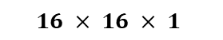

Master Thesis Using Neural Networks for the Domain Adaptation of Synthetic Generated Document Images
Generator Loss
$$16 × 16 × 1$$
$ℒ_{G}={\left(D_{Y}\left(G\left(x_{i}\right)\right) −1 \right)}^{2}$ …(3)
1
1
1
1
1
1
1
1
...
$$16 × 16 × 1$$
1
1
1
1
0
0
0
1
1
1
1
1
G
D_{y}
1
1
1
1
...
...
1
1
1
0
0
0
0
0
Synthetic Image
...
Fake Image
Generator loss
Figure 10: Generator loss in CycleGAN.
Notes:
The synthetic image transformed into a fake image and further passed through a discriminator D_{Y} , We get 16 x 16 vector output, usually general GAN’s discriminator produces scalar output, as the discriminator used in CycleGAN is has a special architecture, the each entry in the output of 16 x 16 vector, predicts a specific patch in an input image being real or fake.
As given in equation synthetic image x_{i} from source domain is passed through generator G again further passed through D_{Y} and mean absolute error is calculated, and that is our generator loss.

Slide 11

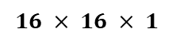
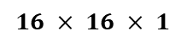

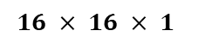
Master Thesis Using Neural Networks for the Domain Adaptation of Synthetic Generated Document Images
Discriminator Loss
$$16 × 16 × 1$$
1
1
1
1
$ℒ_{real, fake}^{D_{Y}} = \frac{1}{2}{\left(D_{Y}(y_{j})−1\right)}^{2}+\frac{1}{2}{\left(D_{Y}({G(x}_{i}))−0\right)}^{2}$ …(4)
1
1
1
1
...
$$16 × 16 × 1$$
1
1
1
1
Discriminator loss
0
0
0
1
1
1
1
1
D_{y}
1
1
1
1
...
...
0
0
0
0
0
0
0
0
$$16 × 16 × 1$$
...
0
0
0
0
Real Image
$$16 × 16 × 1$$
0
0
0
0
...
0
0
0
0
0
0
0
1
D_{y}
...
0
0
0
0
G
1
1
1
1
...
1
1
1
0
0
0
0
0
...
Synthetic Image
Fake Image
Figure 11: Discriminator loss in CycleGAN.
Notes:
Discriminator D_{Y} takes two kinds of inputs, first is real image from the target domain and the fake image produced from generator G.
When it takes real image as an input, then output is minimized with a reference vector containing all values 1. Mean squared error is used to calculate this loss.
Similarly when it takes generated fake image as an input, then the Mean squared error between output and reference vector with all zeros is calculated.
In equation 4 we can see the same operation is occurring, in first part, where real image y_{j} from the target domain passed through D_{Y} and squared difference between output and vectors of 1 is calculated. In second part of equation, the fake image is produced using generator G and passed through discriminator D_{Y} and output squared.
Both losses are added and averaged to produce discriminator loss.

Slide 12
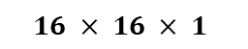
Master Thesis Using Neural Networks for the Domain Adaptation of Synthetic Generated Document Images
Discriminator Architecture
$$16 × 16 × 1$$
...
0
0
0
1
Convolution Layer,
Leaky ReLU(0.2) 64, 4x4, 2
Convolution Layer 1,
Sigmoid, 4x4, 1
Conv. Inst. Norm.
Leaky ReLU(0.2) 128, 4x4, 2
1
1
Conv. Inst. Norm.
Leaky ReLU(0.2) 256, 4x4, 2
1
Conv. Inst. Norm.
Leaky ReLU(0.2) 512, 4x4, 1
1
Conv. Inst. Norm.
Leaky ReLU(0.2) 512, 4x4, 1
1
1
1
0
0
0
0
0
...
256 x 256 x 1
Figure 12: Discriminator architecture in CycleGAN [3].
Notes:
Now lets have a brief look into discriminator architecture, as I have mentioned earlier, the output of the discriminator is 16x 16 vector, where each entry in the output represents a specific patch in an input image being real or fake.
There are 5 down sampling convolution blocks in this architecture.
Now lets have a brief look into architecture of the generator.

Slide 13
Master Thesis Using Neural Networks for the Domain Adaptation of Synthetic Generated Document Images
Generator Architecture
Each block with
2 Conv.
Inst. Norm. ReLU, 3x3, 1
Conv. Inst. Norm. ReLU 128, 3x3, 2
Conv. Inst. Norm. ReLU 256
Trans. Conv. Inst.
Norm. ReLU 64
Conv. Inst. Norm.
ReLU 64, 7x7, 1
Trans. Conv. Inst.
Norm. ReLU 128
256 x 256 x 1
Conv. tanh
256 x 256 x 1
9 Residual Blocks
Downsampling Blocks
Upsampling Blocks
Figure 13: Generator architecture in CycleGAN [3].
Notes:
The generator architecture has 3 parts, first is down sampling block, where input image is down sampled using several convolution layers.
In Second part we have is 9 ResNet blocks, to tackle the problem of vanishing gradients.
In third part we have transposed convolution layer to up sample the input image back to its original dimension.
This was all about the CycleGAN, now lets have a look into Experiments conducted in this thesis.

Slide 14
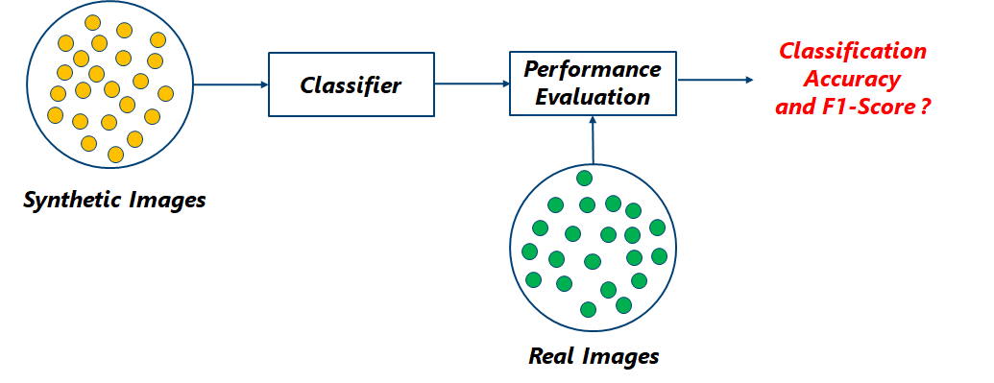
Master Thesis Using Neural Networks for the Domain Adaptation of Synthetic Generated Document Images
Experiment 1
Analyze domain gap between synthetic and real data distribution.
Figure 14: Train a classifier on synthetic images and test on real images.
Notes:
First experiment was to train a CycleGAN using synthetic images and real images.
In next experiments we will train three different classifier using three different data distributions and analyse domain gap between these data distribution and real data distribution.
For example, we will train a classifier using synthetic images to test on the real images, to understand domain gap between synthetic data distribution and real data distribution.
Next, we will faxify the synthetic images using faxification process, and created faxified images. Then a classifier trained using faxified image, tested on real images, to understand domain gap between faxified data distribution and real data distribution.
In coming slides we will see how the faxified and synthetic images are is created and datasets used in this thesis.
Now the most important experiment of the thesis is determining the quality of fake images generated by the generator G, which transforms synthetic images into fake images that are similar to the actual real images. For this, we train a classifier on fake images and test it on real images.
The idea is behind this experiment is, if this classifier performs well on real images, then we can say the quality of fake images is good otherwise they are bad.
Now lets have look into the process of synthetic and faxified data creation process.

Slide 15
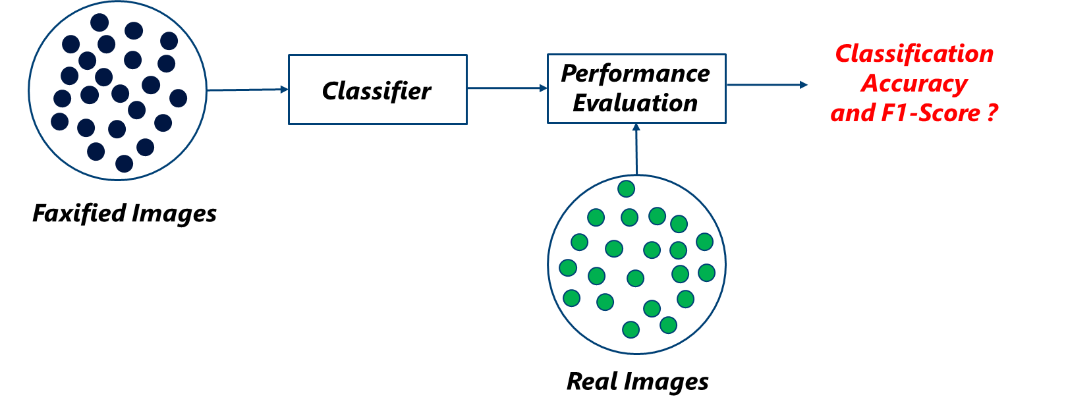
Master Thesis Using Neural Networks for the Domain Adaptation of Synthetic Generated Document Images
Experiment 2
Analyze domain gap between faxified and real data distribution.
Figure 15: Train a classifier on faxified images and test on real images.
Notes:
First experiment was to train a CycleGAN using synthetic images and real images.
In next experiments we will train three different classifier using three different data distributions and analyse domain gap between these data distribution and real data distribution.
For example, we will train a classifier using synthetic images to test on the real images, to understand domain gap between synthetic data distribution and real data distribution.
Next, we will faxify the synthetic images using faxification process, and created faxified images. Then a classifier trained using faxified image, tested on real images, to understand domain gap between faxified data distribution and real data distribution.
In coming slides we will see how the faxified and synthetic images are is created and datasets used in this thesis.
Now the most important experiment of the thesis is determining the quality of fake images generated by the generator G, which transforms synthetic images into fake images that are similar to the actual real images. For this, we train a classifier on fake images and test it on real images.
The idea is behind this experiment is, if this classifier performs well on real images, then we can say the quality of fake images is good otherwise they are bad.
Now lets have look into the process of synthetic and faxified data creation process.

Slide 16
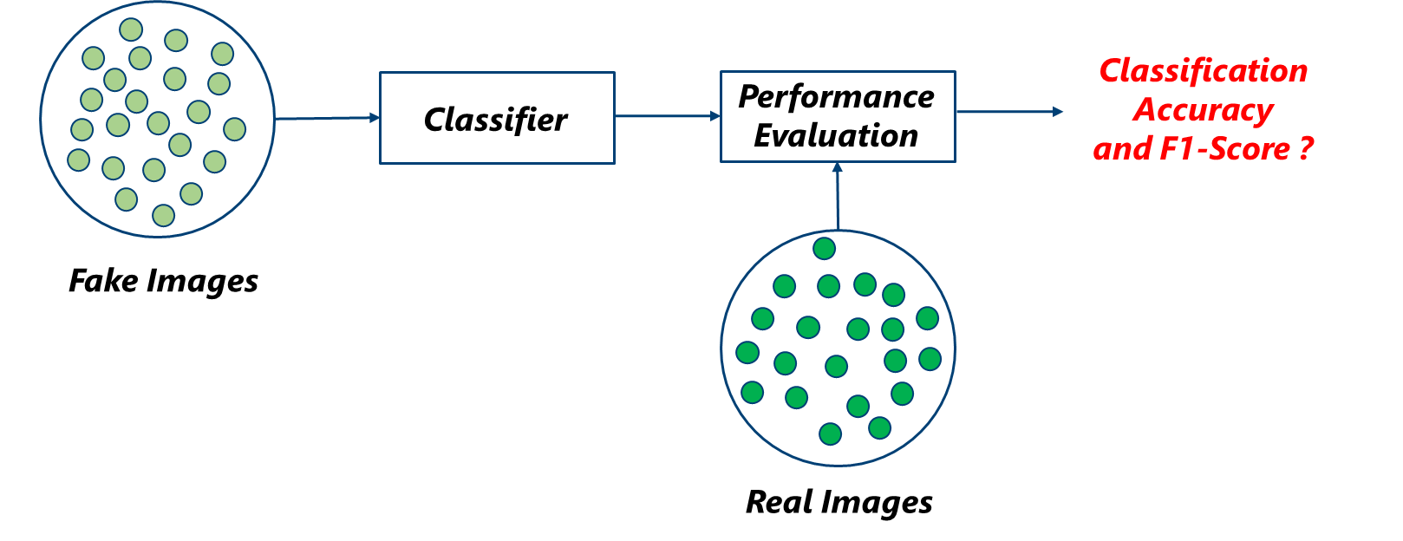
Master Thesis Using Neural Networks for the Domain Adaptation of Synthetic Generated Document Images
Experiment 3
Analyze domain gap between fake and real data distribution.
Decides the quality of fake images.
Figure 16: Train a classifier on fake images and test on real images.
Notes:
First experiment was to train a CycleGAN using synthetic images and real images.
In next experiments we will train three different classifier using three different data distributions and analyse domain gap between these data distribution and real data distribution.
For example, we will train a classifier using synthetic images to test on the real images, to understand domain gap between synthetic data distribution and real data distribution.
Next, we will faxify the synthetic images using faxification process, and created faxified images. Then a classifier trained using faxified image, tested on real images, to understand domain gap between faxified data distribution and real data distribution.
In coming slides we will see how the faxified and synthetic images are is created and datasets used in this thesis.
Now the most important experiment of the thesis is determining the quality of fake images generated by the generator G, which transforms synthetic images into fake images that are similar to the actual real images. For this, we train a classifier on fake images and test it on real images.
The idea is behind this experiment is, if this classifier performs well on real images, then we can say the quality of fake images is good otherwise they are bad.
Now lets have look into the process of synthetic and faxified data creation process.

Slide 17
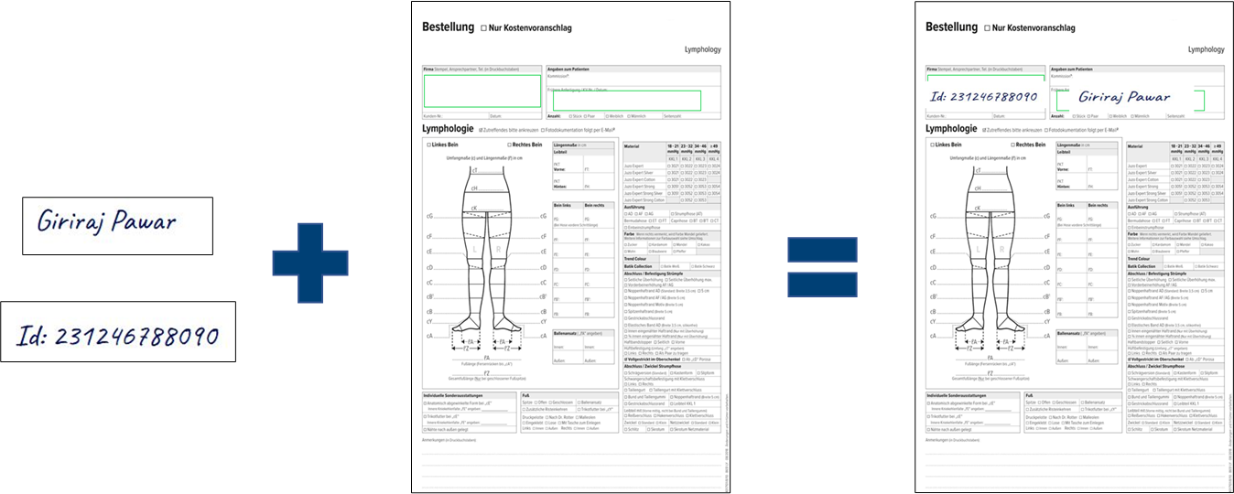
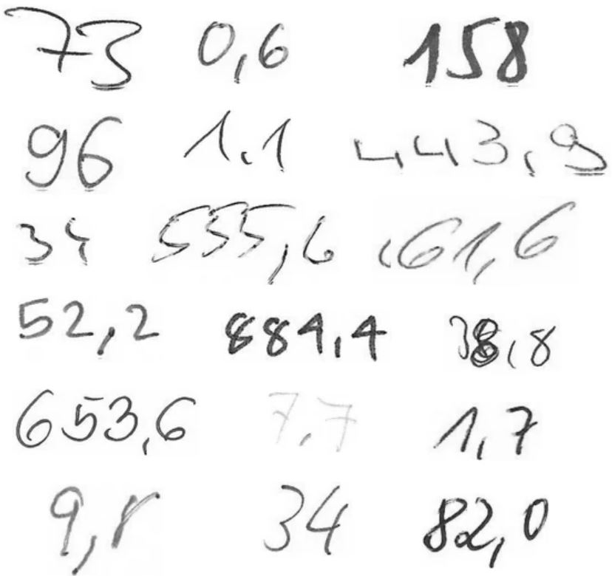
Master Thesis Using Neural Networks for the Domain Adaptation of Synthetic Generated Document Images
Synthetic Images Creation Process
Figure 17: Inserting handwritten crops in empty form templates.
Figure 18: Examples of handwritten crops from handwriting number dataset.
Notes:
1. The synthetic images are created by pasting handwritten crops these on empty templates.
2. Sample handwritten crops can be seen here.

Slide 18
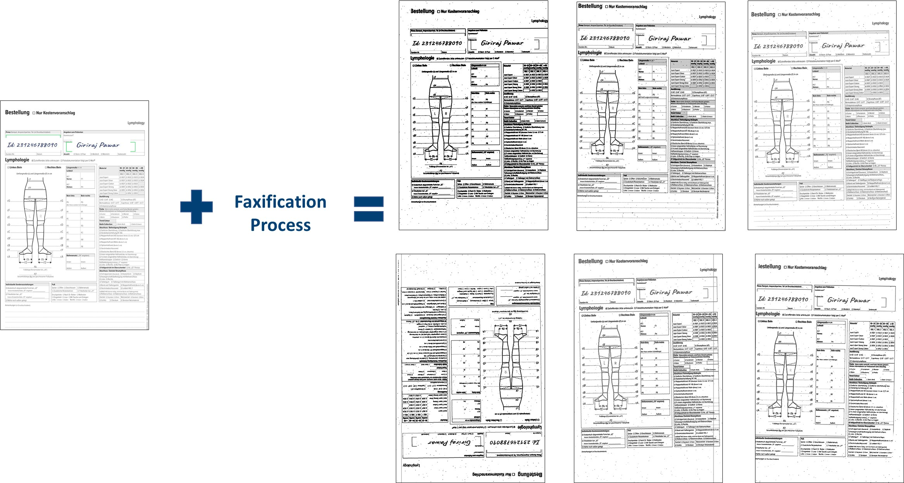
Master Thesis Using Neural Networks for the Domain Adaptation of Synthetic Generated Document Images
Faxified Images Creation Process
Conversion to grayscale
Brightness transform
Binarization
Rotate 180 Degrees
Adding Noise
Gamma Transformation
Figure 19: An illustration of faxification process applied on synthetic images.
Notes:
1. So now we have synthetic images, next we faxify them using faxification process, which is an image processing tool.
2. This process mimics the way fax machine works.
3. It has steps like
Conversion to grayscale
Brightness transform
Binarization
Rotate 180 Degrees
Adding Noise
Gamma Transformation

Slide 19
Master Thesis Using Neural Networks for the Domain Adaptation of Synthetic Generated Document Images
Datasets
Classes | Size (Number of Images)
DE_LY_Arm_2020-01 | 44
DE_LY_Bein_2018-08 | 47
DE_LY_Bein_2019-01 | 50
DE_LY_Bein_2019-07 | 60
DE_LY_Bein_2020-01 | 624
DE_LY_Bein_2020-03 | 128
DE_LY_Hand_2020-01 | 16
DE_PH_Bein_2018-09 | 22
DE_PH_Bein_2019-02 | 28
DE_PH_Bein_2020-01 | 143
Datasets | Size (Number of Images)
Synthetic images | 100,000 (each class 10,000)
Real images | 100,000 (random)
Faxified images | 100,000 (each class 10,000)
testing real images | 1162
Table 1: Size of datasets used for training CycleGAN and classifiers.
Table 2: Number of images in each class of testing real images dataset.
Notes:
Now, lets have an overview of datasets used in this thesis.
We have around 100,000 synthetic images, 10000 from each class.
We have random 100,000 real images, which we have used to train CycleGAN.
We have faxified 100,000 synthetic images, so we have 100,000 faxified images, and 10000 from each class.
We have 1162 real images kept aside for testing. The testing dataset is unbalanced.
Most important thing to observe here is the classes used in thesis mostly belongs to class Bein and they are really similar to each other.
Arm and Hand are ony teDistinct classes are.
Now we move forward towards quantitative results of the experiments performed in this thesis.

Slide 20
Master Thesis Using Neural Networks for the Domain Adaptation of Synthetic Generated Document Images
Quantitative Results
Classifier trained using | Accuracy | Weighted F1-score | Macro F1-score
Synthetic images | 25% | 31% | 27%
Faxified images | 43% | 43% | 58%
Fake images | 27% | 25% | 34%
Table 3: Table of accuracies and F1-Scores when a classifier trained
on different data distributions.
Figure 20: Comparison of accuracies and F1-Scores when a classifier trained
on different data distributions.
Notes:
As mentioned earlier, we have trained three different classifiers on three different data distributions.
It was expected that the classifier trained using synthetic images will not perform well on real images. Hence the accuracy and f1 scores are very less.
The classifier trained using fake images also did not perform well, with this it can be said, the quality of fake images still need to be improved so can match the distribution of real images.
Overall, results show that the faxified images matched the distribution of real images.
Now, let us have a look at plotted confusion matrices after testing, so we can see class level classification performance.
The classifiers trained using synthetic images and fake images performed very bad on real images.
The accuracy and f1-scores show classifier trained using faxified images performed well on real images.
These quantitative results clearly show that faxified images are more similar to real images and the CycleGAN generated fake images are not similar enough to real images.
Next, Let’s have a look into the confusion matrices plotted after testing these classifiers.

Slide 21
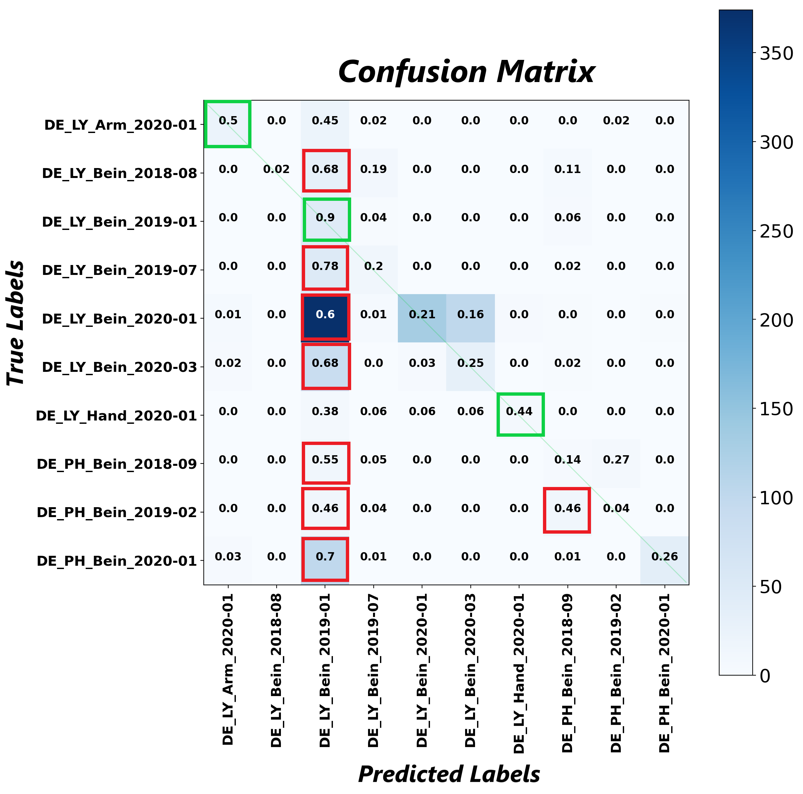
Master Thesis Using Neural Networks for the Domain Adaptation of Synthetic Generated Document Images
Train a classifier on
synthetic images and
test on real images.
Figure 21: Confusion matrix. Testing a classifier trained on synthetic images using real images.
Notes:
1. When a classifier trained on synthetic images, and tested on real images, most of the classed are misclassified.
2. The green boxes represent classes that are correctly classified and red boxes represents classes that are misclassified.

Slide 22
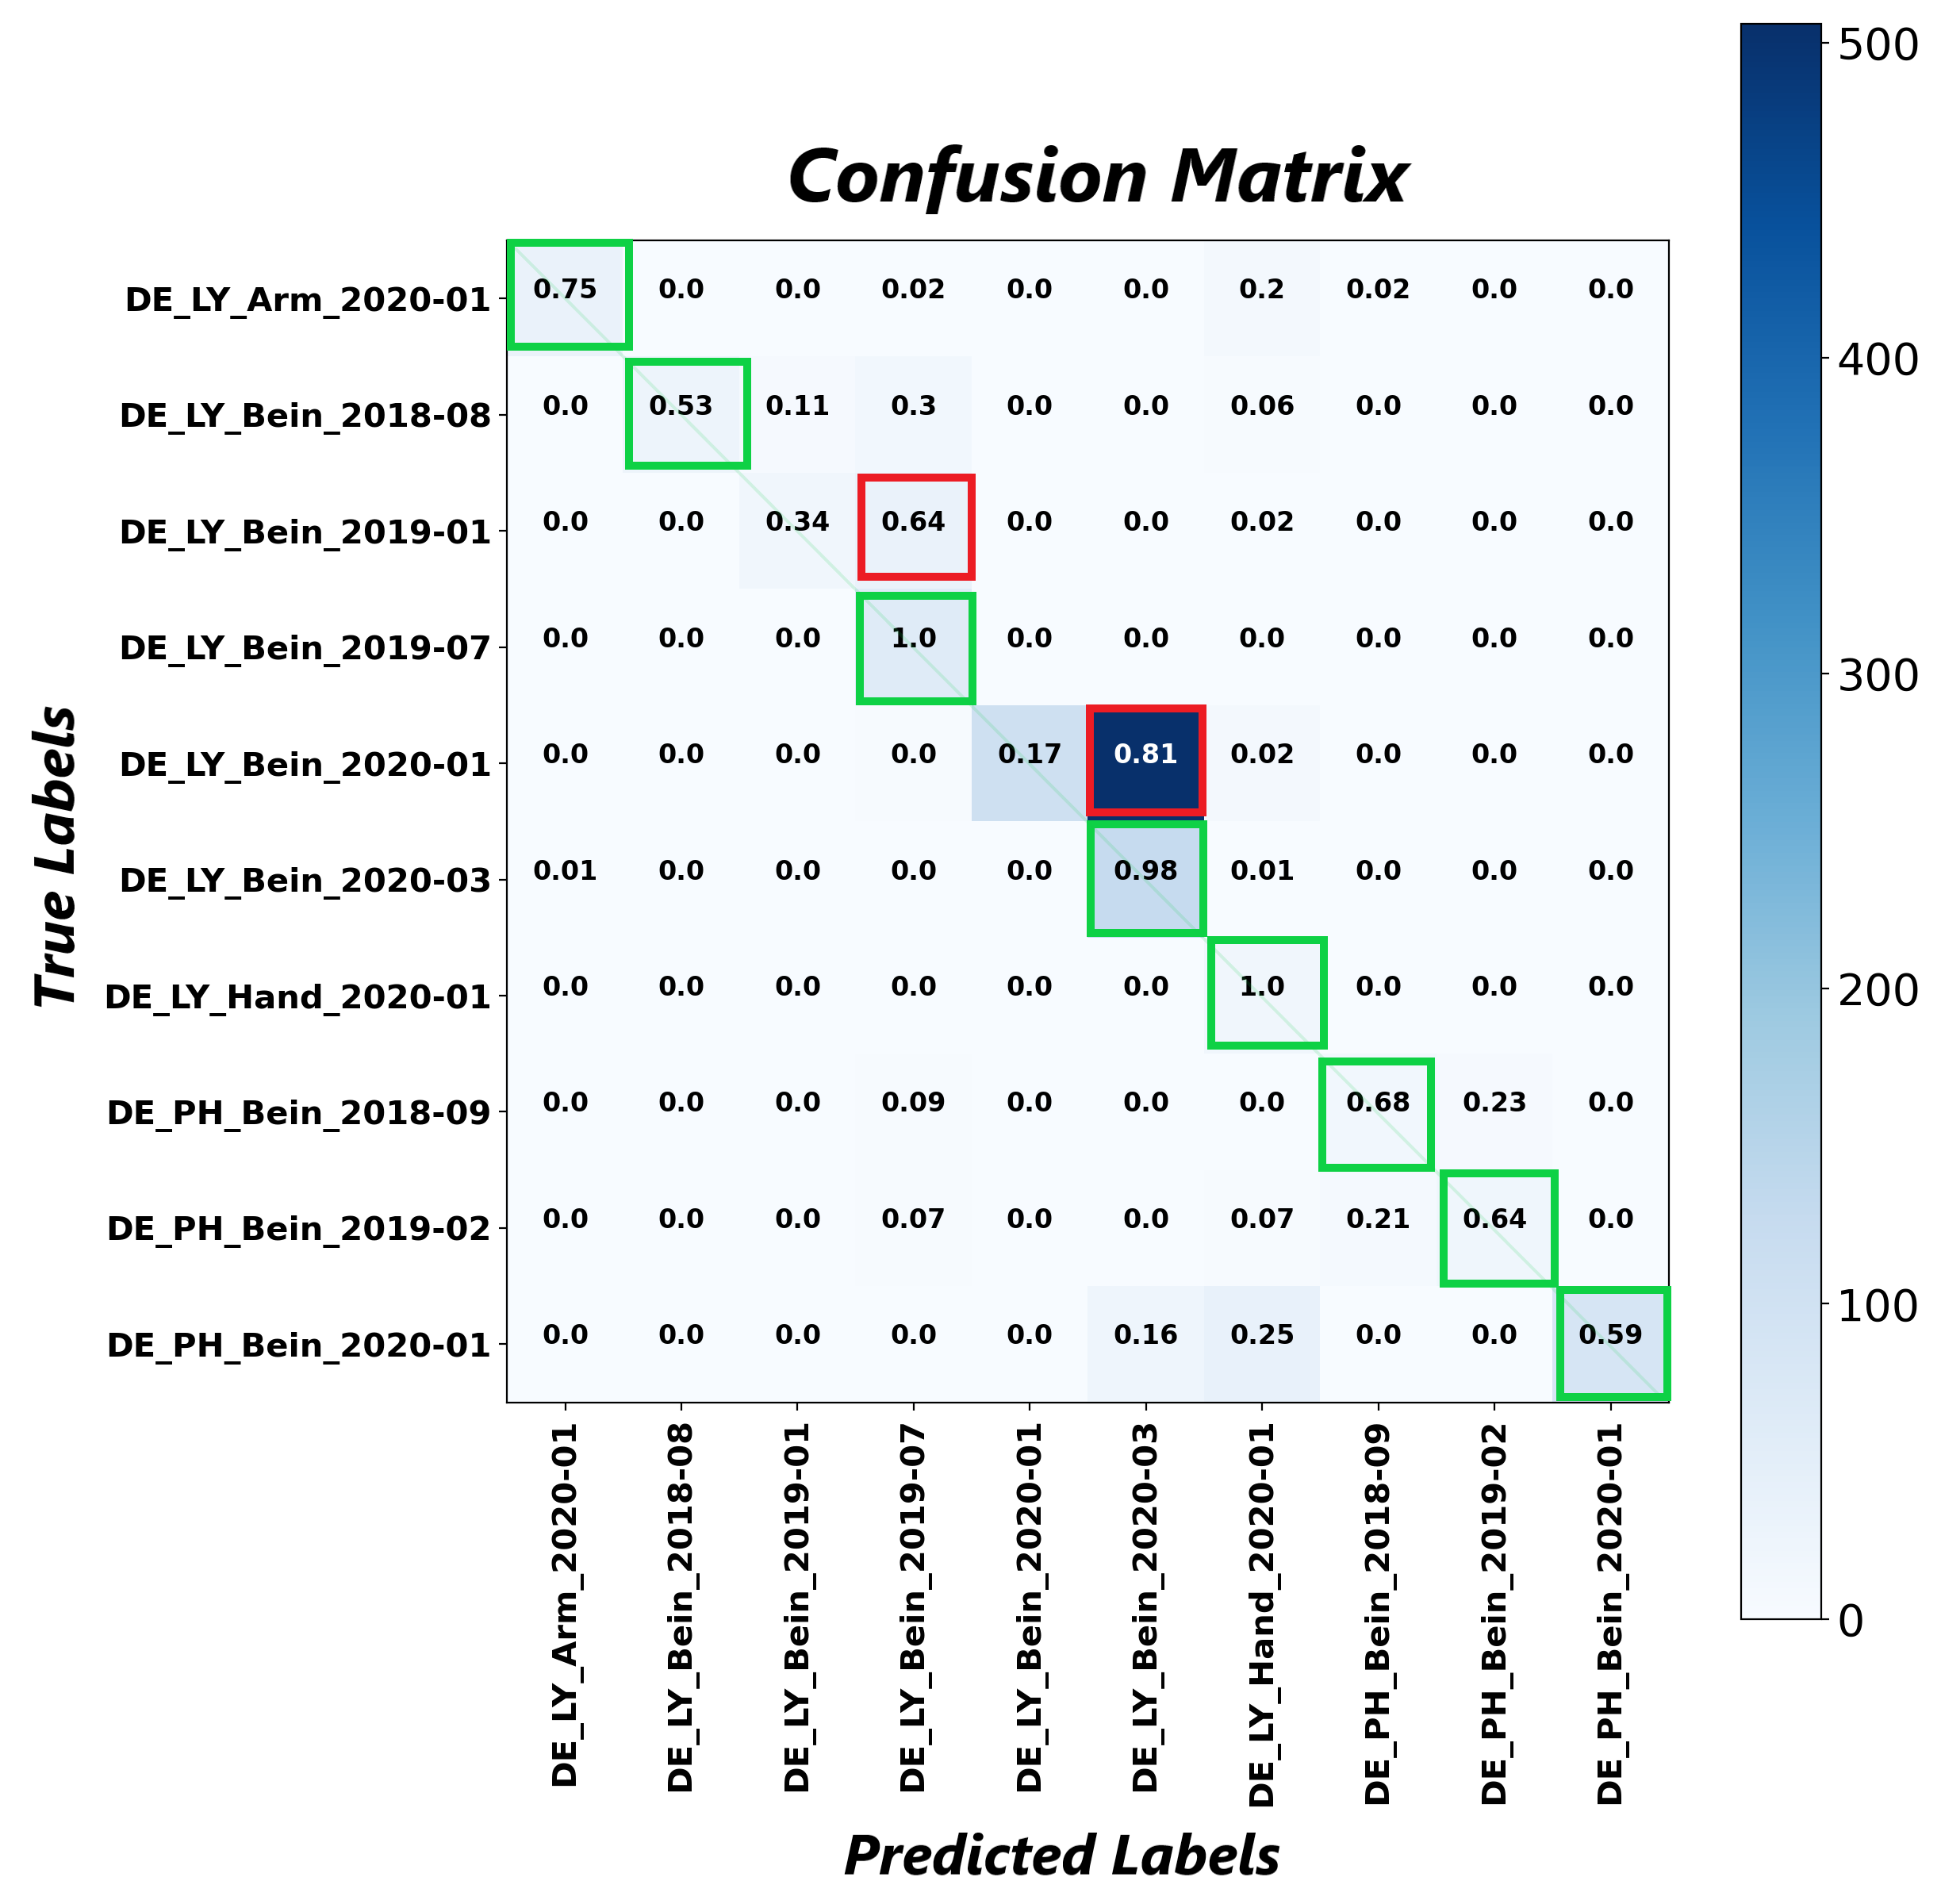
Master Thesis Using Neural Networks for the Domain Adaptation of Synthetic Generated Document Images
Train a classifier on faxified images and test on real images.
Figure 19: Confusion matrix. Testing a classifier trained on faxified images using real images.
Notes:
As mentioned earlier, the faxified images are similar to real images, hence only two classes are misclassified.
Let’s see an example of misclassified class.

Slide 23
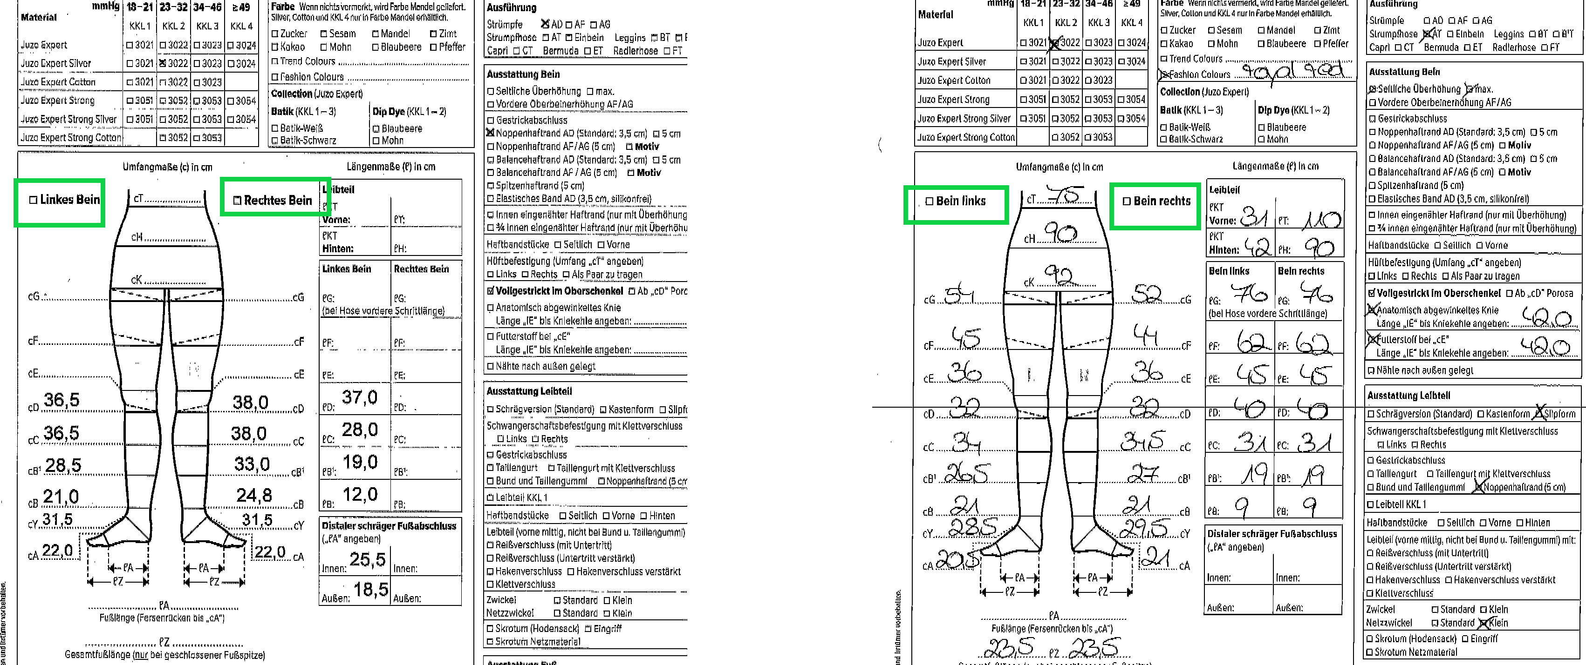
Master Thesis Using Neural Networks for the Domain Adaptation of Synthetic Generated Document Images
Example of Misclassified Image
DE_LY_Bein_2020-1
DE_LY_Bein_2020-3
Figure 22: Real images DE_LY_Bein_2020-1 and DE_LY_Bein_2020-3 are very similar to each other.

Slide 24
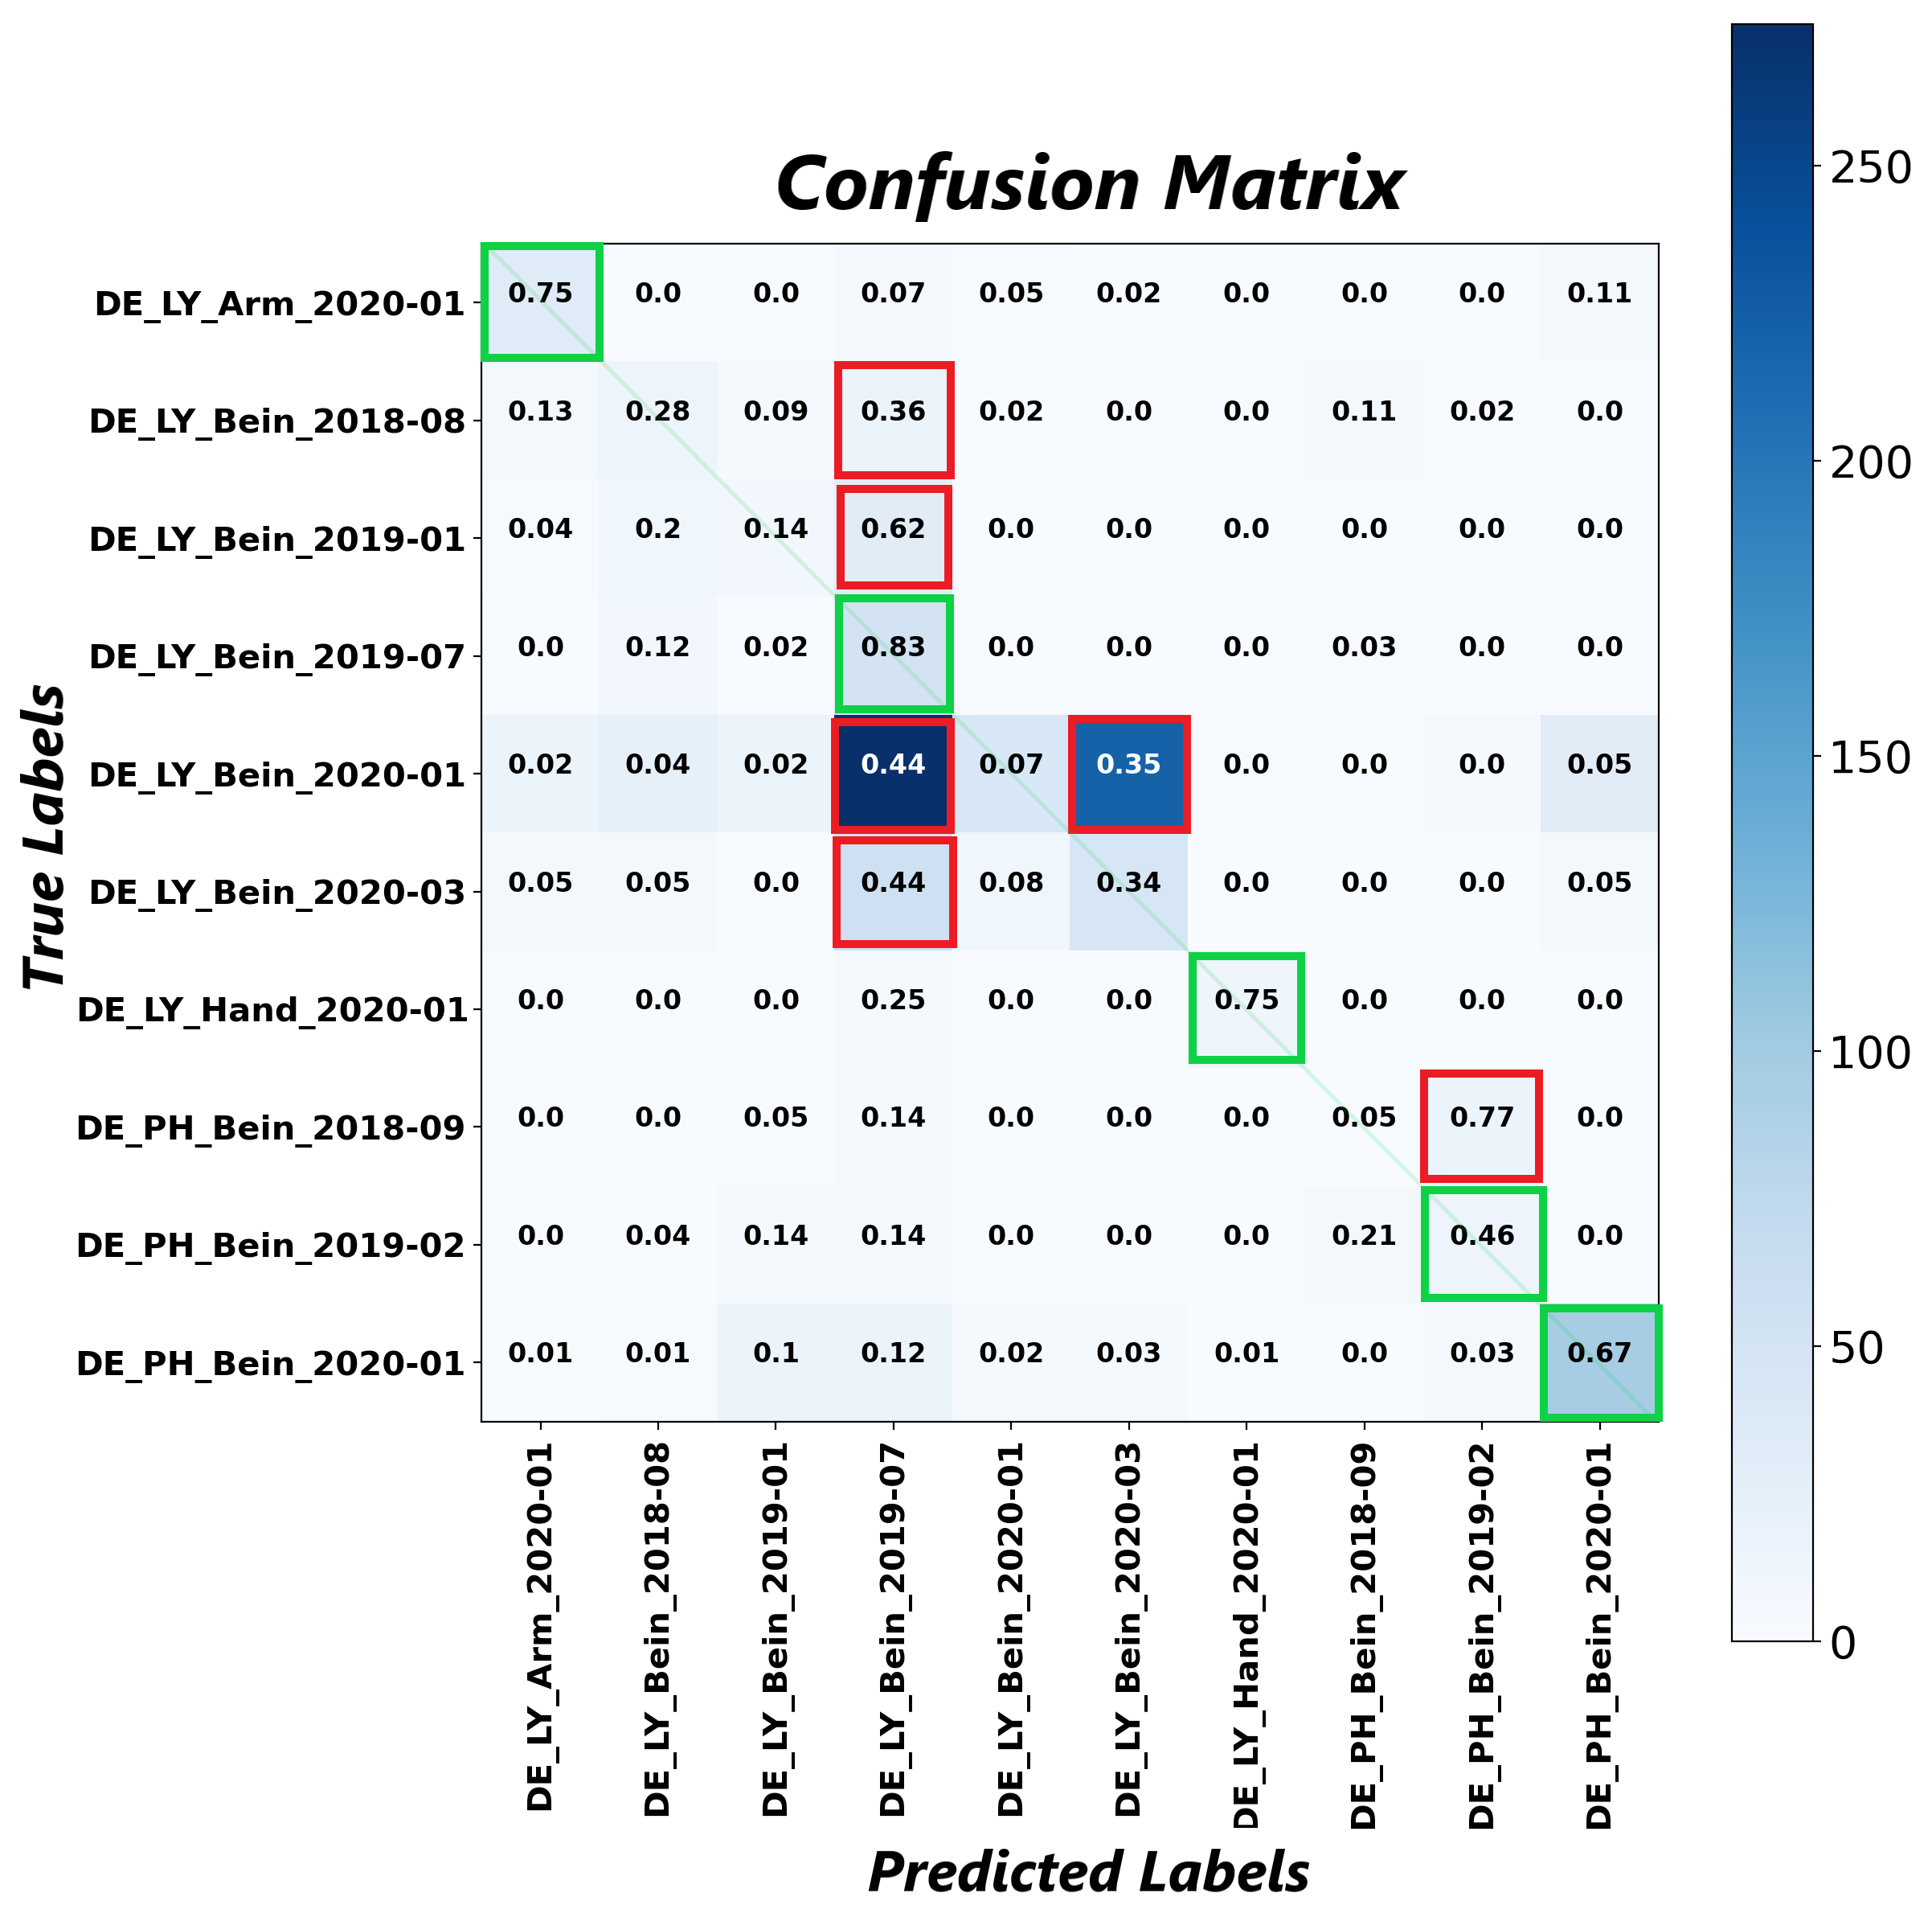
Master Thesis Using Neural Networks for the Domain Adaptation of Synthetic Generated Document Images
Train a classifier using fake images and test on real images.
Determines the quality of fake images.
Figure 23: Confusion matrix. Testing a classifier trained on fake images using real images.
Notes:
When a classifier trained on fake images, and tested on real images, 5 classes are classified well, especially distinct classes Arm and Hand.
The Bein class images are similar to each other CycleGAN has failed to learn such minor features, hence most of the Bein class images are misclassified.
Let’s see an example about misclassification as Bein_2019-01 is misclassified as Bein_2019-07

Slide 25
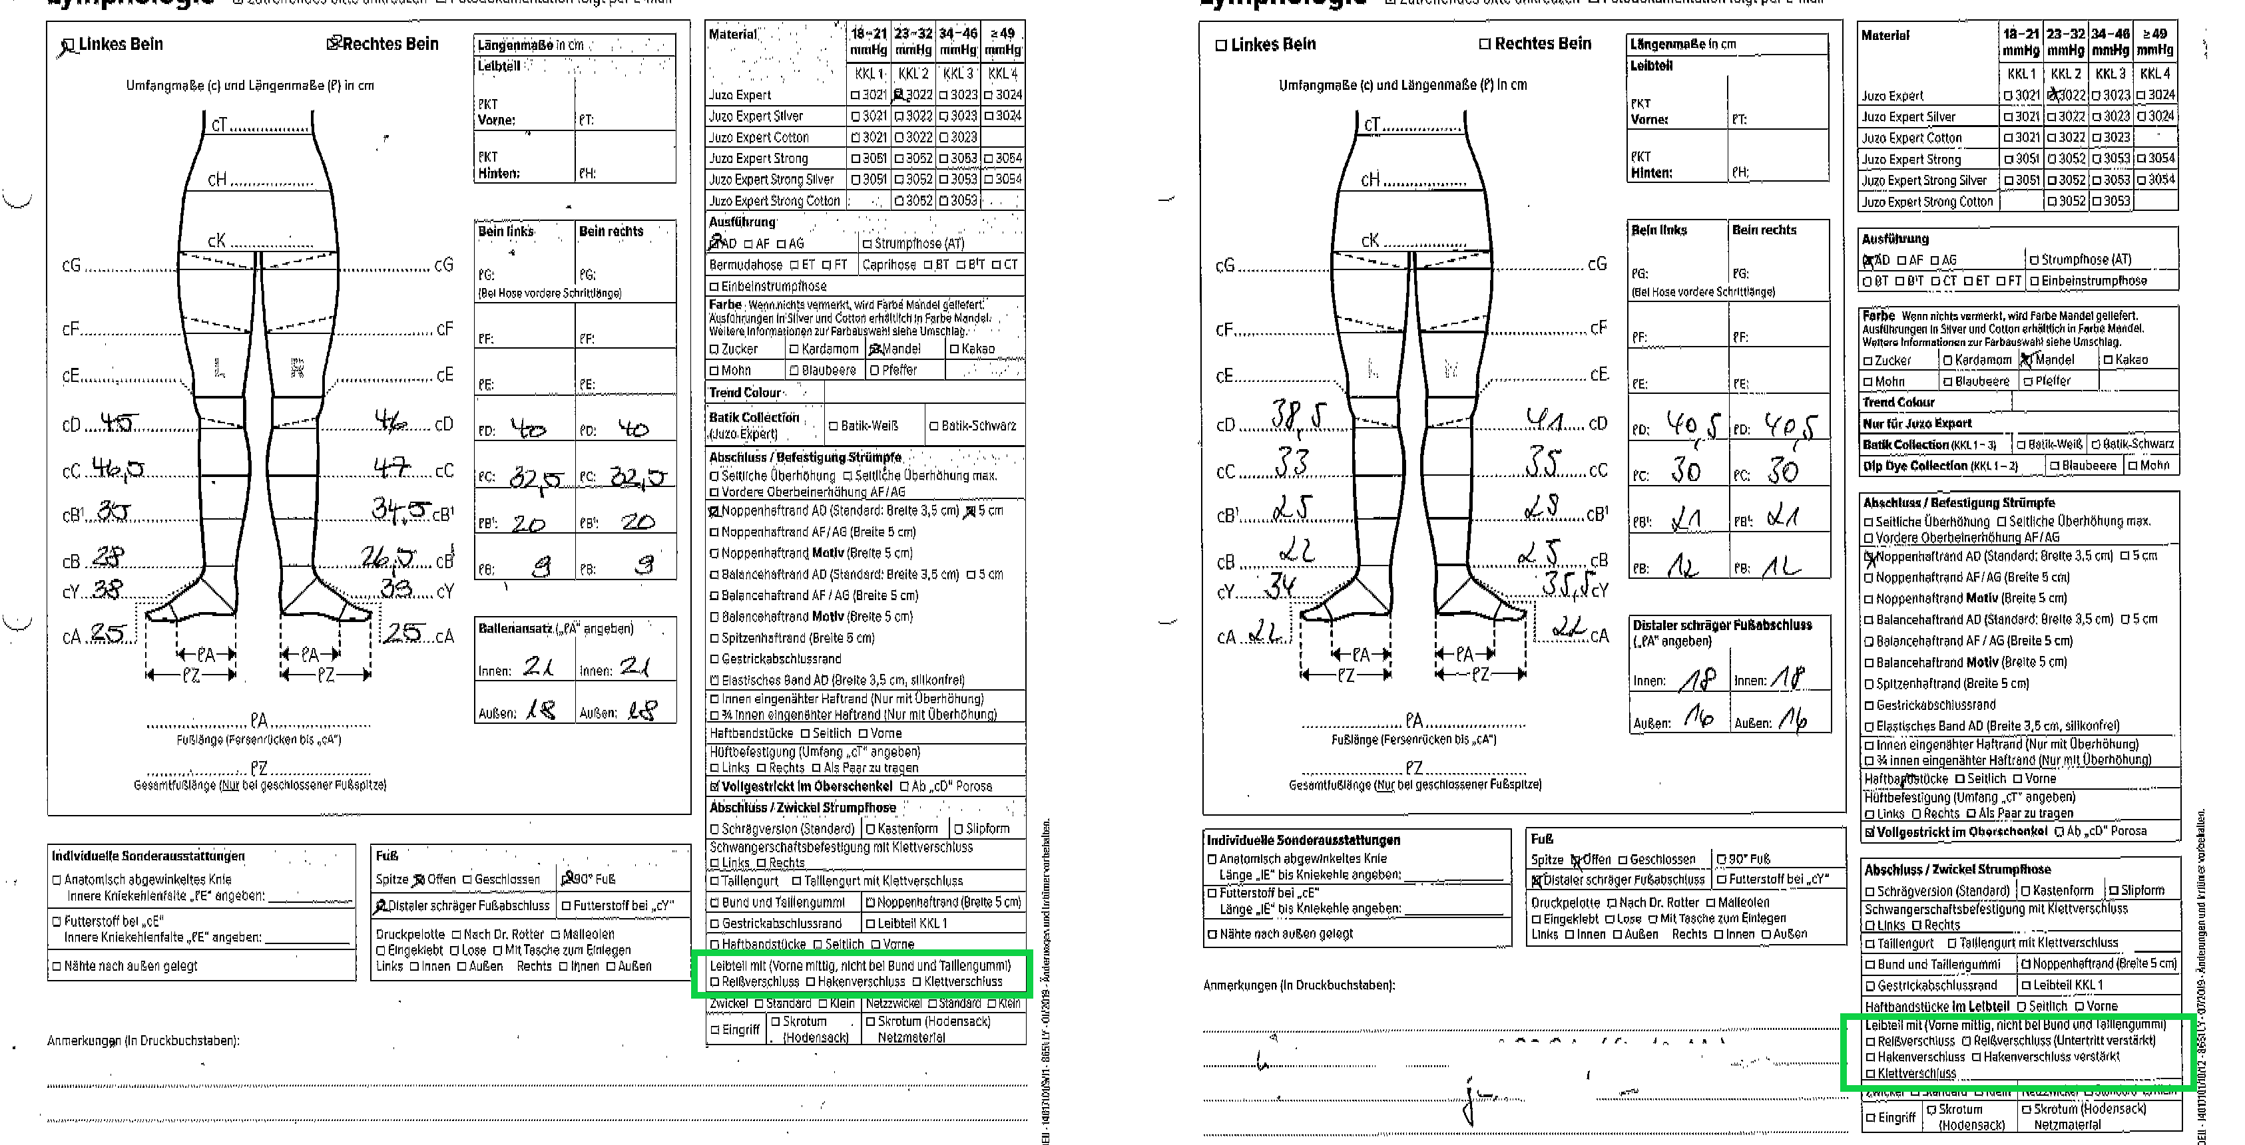
Master Thesis Using Neural Networks for the Domain Adaptation of Synthetic Generated Document Images
Example of Misclassified Image
DE_LY_Bein_2019-1
DE_LY_Bein_2019-7
Figure 24: Real images DE_LY_Bein_2019-1 and DE_LY_Bein_2019-7 are very similar to each other.
Notes:
These two images have really small and minute differences, CyleGAN has failed to learn such minor features from the training dataset.
Now lets see some examples of generated fake images.

Slide 26
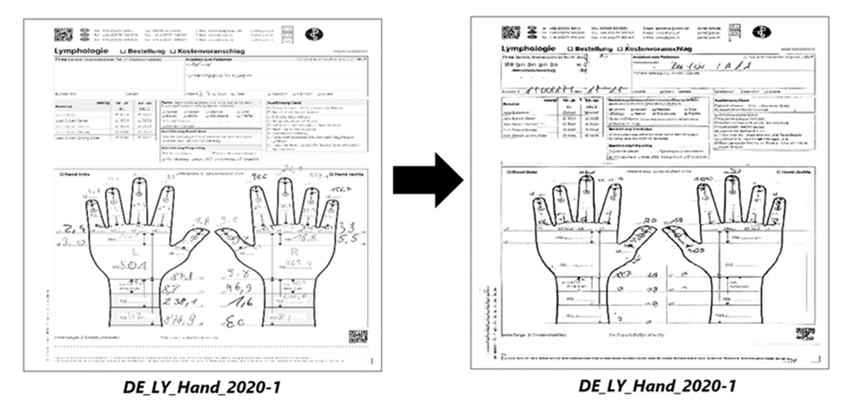
Master Thesis Using Neural Networks for the Domain Adaptation of Synthetic Generated Document Images
Qualitative Results
Synthetic Image
Fake Image
Figure 25: Qualitative Results.
Notes:
Major artifacts present in an image are generated very well. No discuss some failure cases.

Slide 27
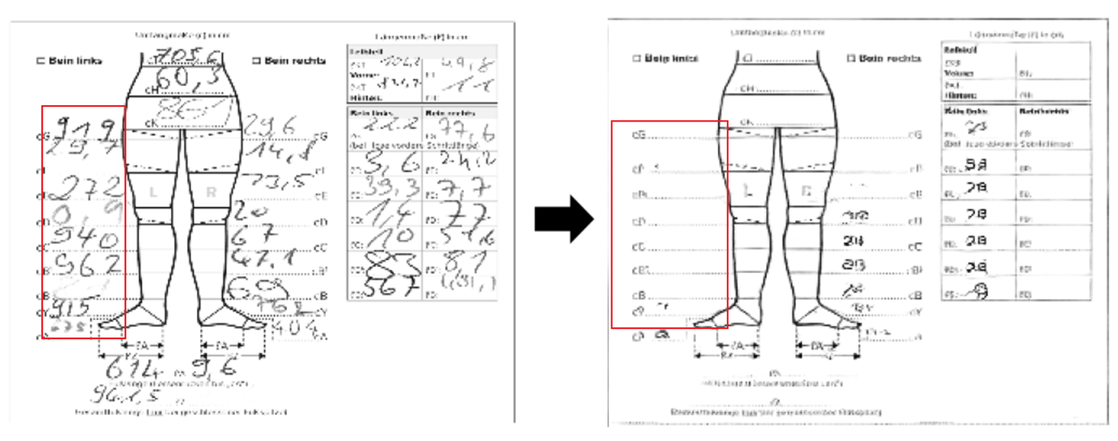
Master Thesis Using Neural Networks for the Domain Adaptation of Synthetic Generated Document Images
Failure Case 1
Snippet from Synthetic Image
Snippet from Fake Image
Figure 26: The snippet from fake image illustrates that the CycleGAN did not transform handwritten crops in the target domain from the synthetic image in the source domain.
Notes:
Handwritten crops from synthetic image did not get transformed in the fake image.

Slide 28
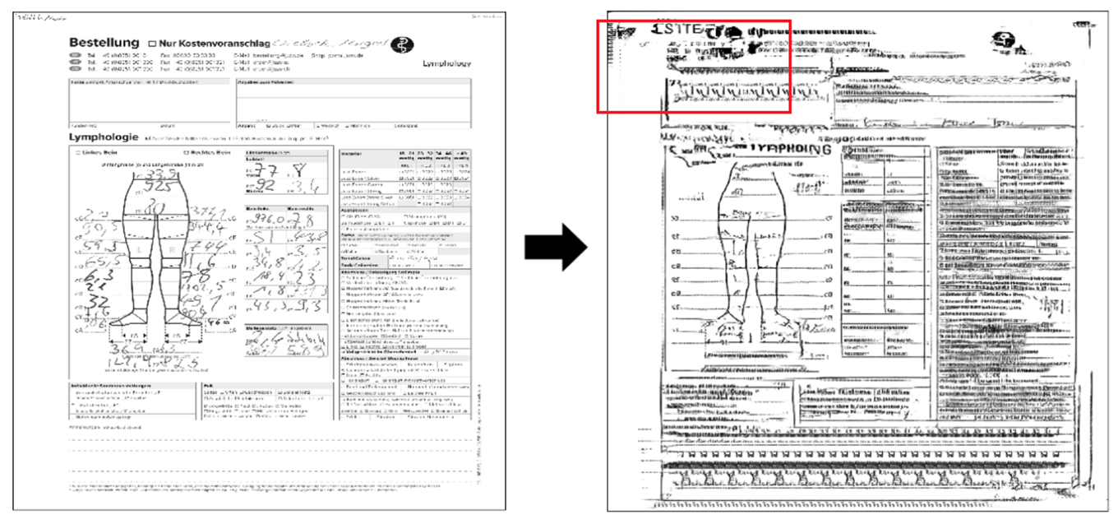
Master Thesis Using Neural Networks for the Domain Adaptation of Synthetic Generated Document Images
Failure Case 2
Synthetic Image
Fake Image
Figure 27: The fake image consists of unrealistic noisy artifacts.
Notes:
Another example of failure case, in which fake image has unrealistic noisy artifacts.
Now we will move towards conclusion.

Slide 29
Master Thesis Using Neural Networks for the Domain Adaptation of Synthetic Generated Document Images
Conclusion
Fake images visually looked promising and must be improved in the future.
Handwritten crops transformation failed.
Major artifacts transformation was satisfactory.
Minor features and differences increased the complexity, hence the quality of fake images of Bein class was not satisfactory.
Faxified images were similar to the real images.

Slide 30
Master Thesis Using Neural Networks for the Domain Adaptation of Synthetic Generated Document Images
Future Work
Comparison and implementation with other methodologies and loss functions is kept for future work.
Computationally expensive. Multiple GPUs and parallel programming.
Wasserstein loss function [6].
Improve handwriting recognition models.
There is a scope of data analysis and cleaning. Random real images collection. They are not equally distributed.

Slide 31
Master Thesis Using Neural Networks for the Domain Adaptation of Synthetic Generated Document Images
Thank You
Questions?

Slide 32
Master Thesis Using Neural Networks for the Domain Adaptation of Synthetic Generated Document Images
References
[1] Ian J. Goodfellow, Jean Pouget-Abadie, Mehdi Mirza, Bing Xu, David Warde-Farley, Sherjil
Ozair, Aaron Courville, and Yoshua Bengio. Generative adversarial networks, 2014.
[2] Phillip Isola, Jun-Yan Zhu, Tinghui Zhou, and Alexei A. Efros. Image-to-image translation with
conditional adversarial networks, 2018.
[3] Jun-Yan Zhu, Taesung Park, Phillip Isola, and Alexei A. Efros. Unpaired image-to-image translation using cycle-consistent adversarial networks, 2020.
[4] Yuval Netzer, Tao Wang, Adam Coates, Alessandro Bissacco, Bo Wu, and Andrew Y. Ng. Reading
digits in natural images with unsupervised feature learning. In NIPS Workshop on Deep Learning
and Unsupervised Feature Learning 2011.
[5] M. R. Pavan Kumar and Prabhu Jayagopal. Generative adversarial networks: a survey on applications and challenges. International Journal of Multimedia Information Retrieval, 2021.
[6] Martin Arjovsky, Soumith Chintala, and L´eon Bottou. Wasserstein gan, 2017.

Slide 33
Master Thesis Using Neural Networks for the Domain Adaptation of Synthetic Generated Document Images
Backup Slides

Slide 34
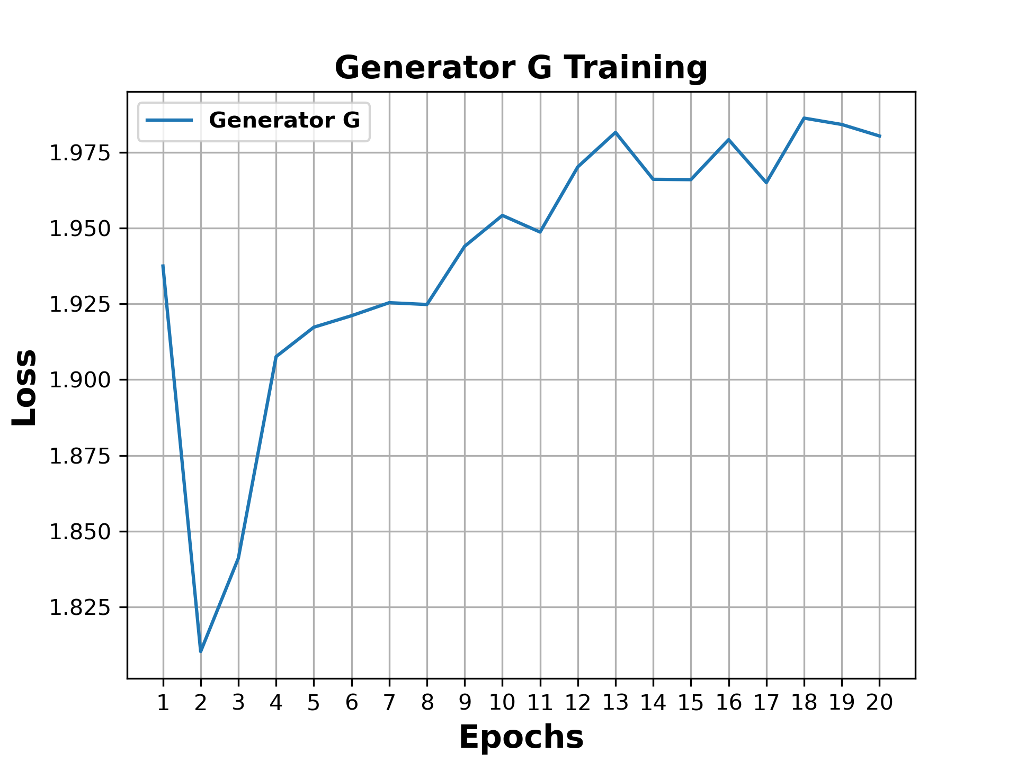
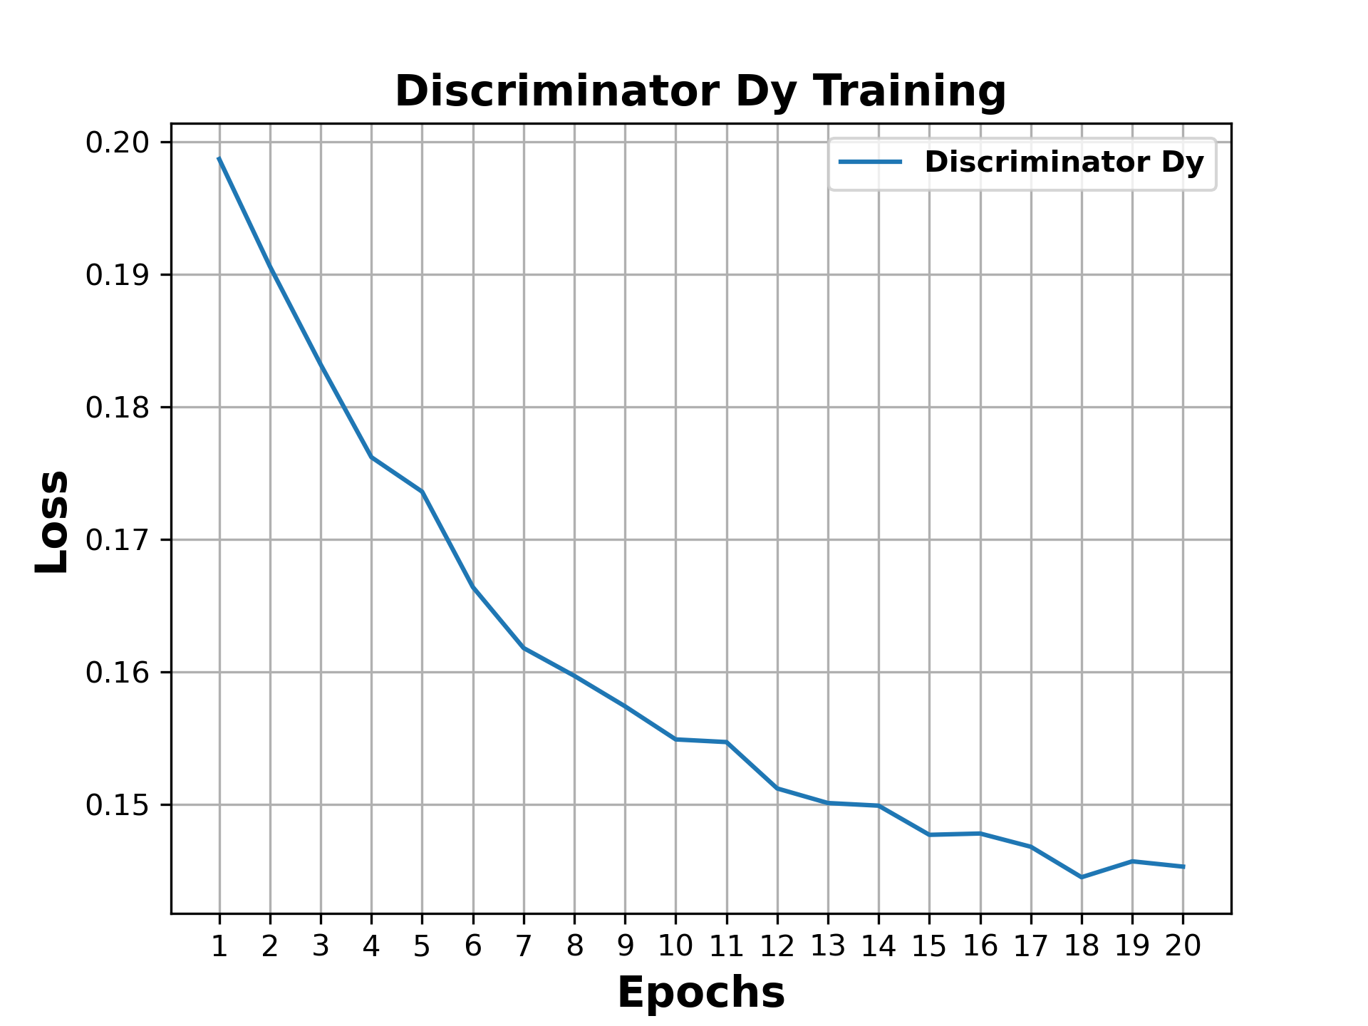
Master Thesis Using Neural Networks for the Domain Adaptation of Synthetic Generated Document Images
Generator G and Discriminator D_{Y} Training Curves
Figure: Epochs vs. Loss plot during Generator G is Training.
Figure: Epochs vs. Loss plot during Discriminator$D_{Y}$is training.

Slide 35
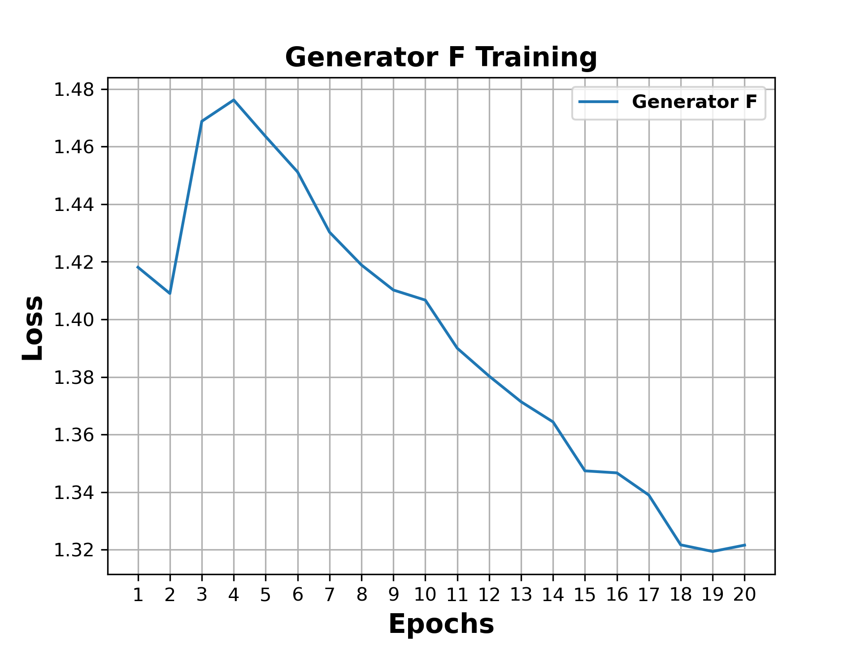
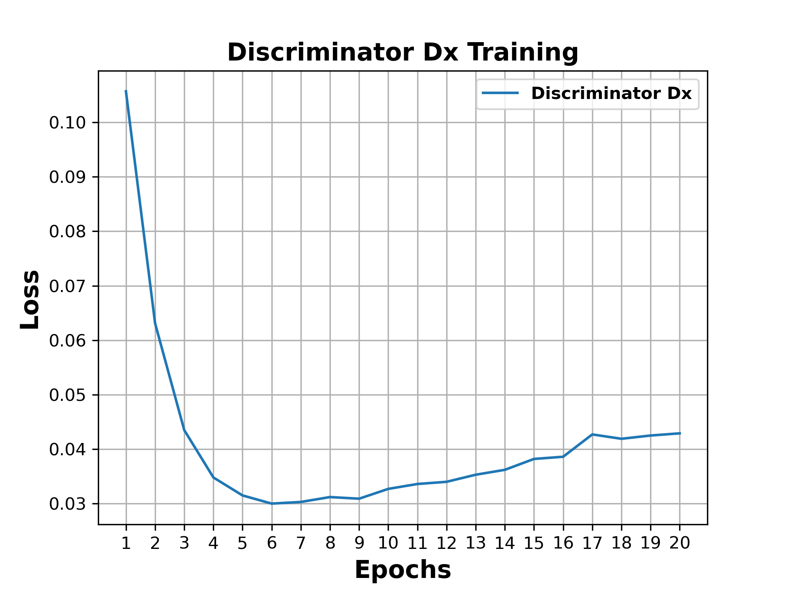
Master Thesis Using Neural Networks for the Domain Adaptation of Synthetic Generated Document Images
Generator F and Discriminator D_{X} Training Curves
Figure: Epochs vs. Loss plot during Generator F is Training.
Figure: Epochs vs. Loss plot during Discriminator $D_{X}$ is training.

Slide 36
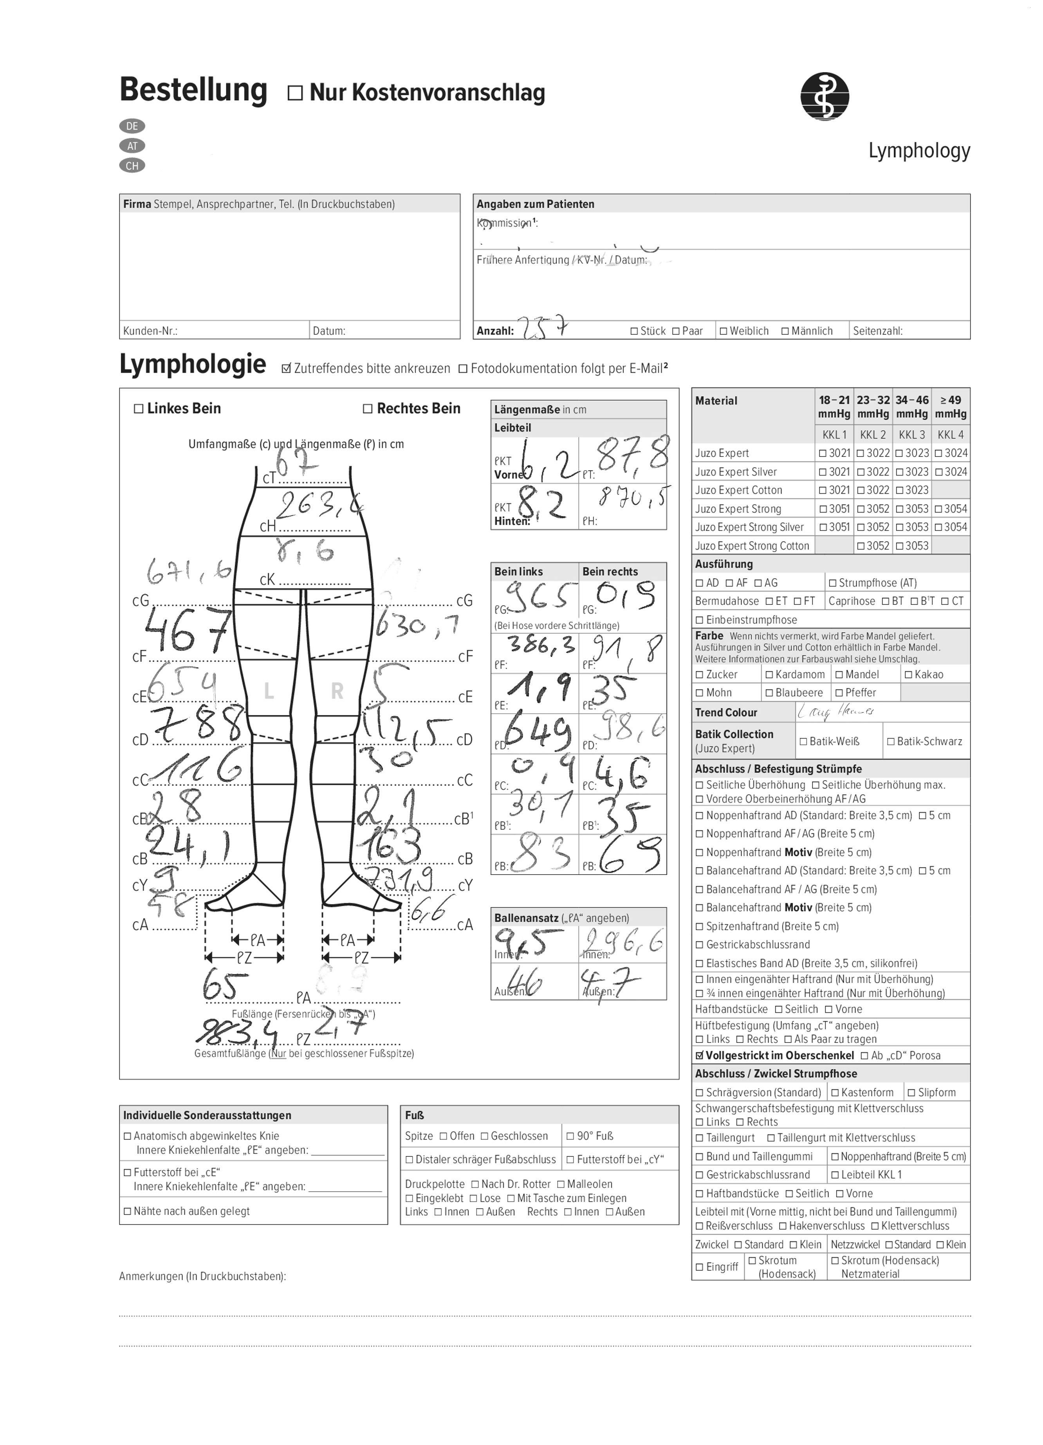
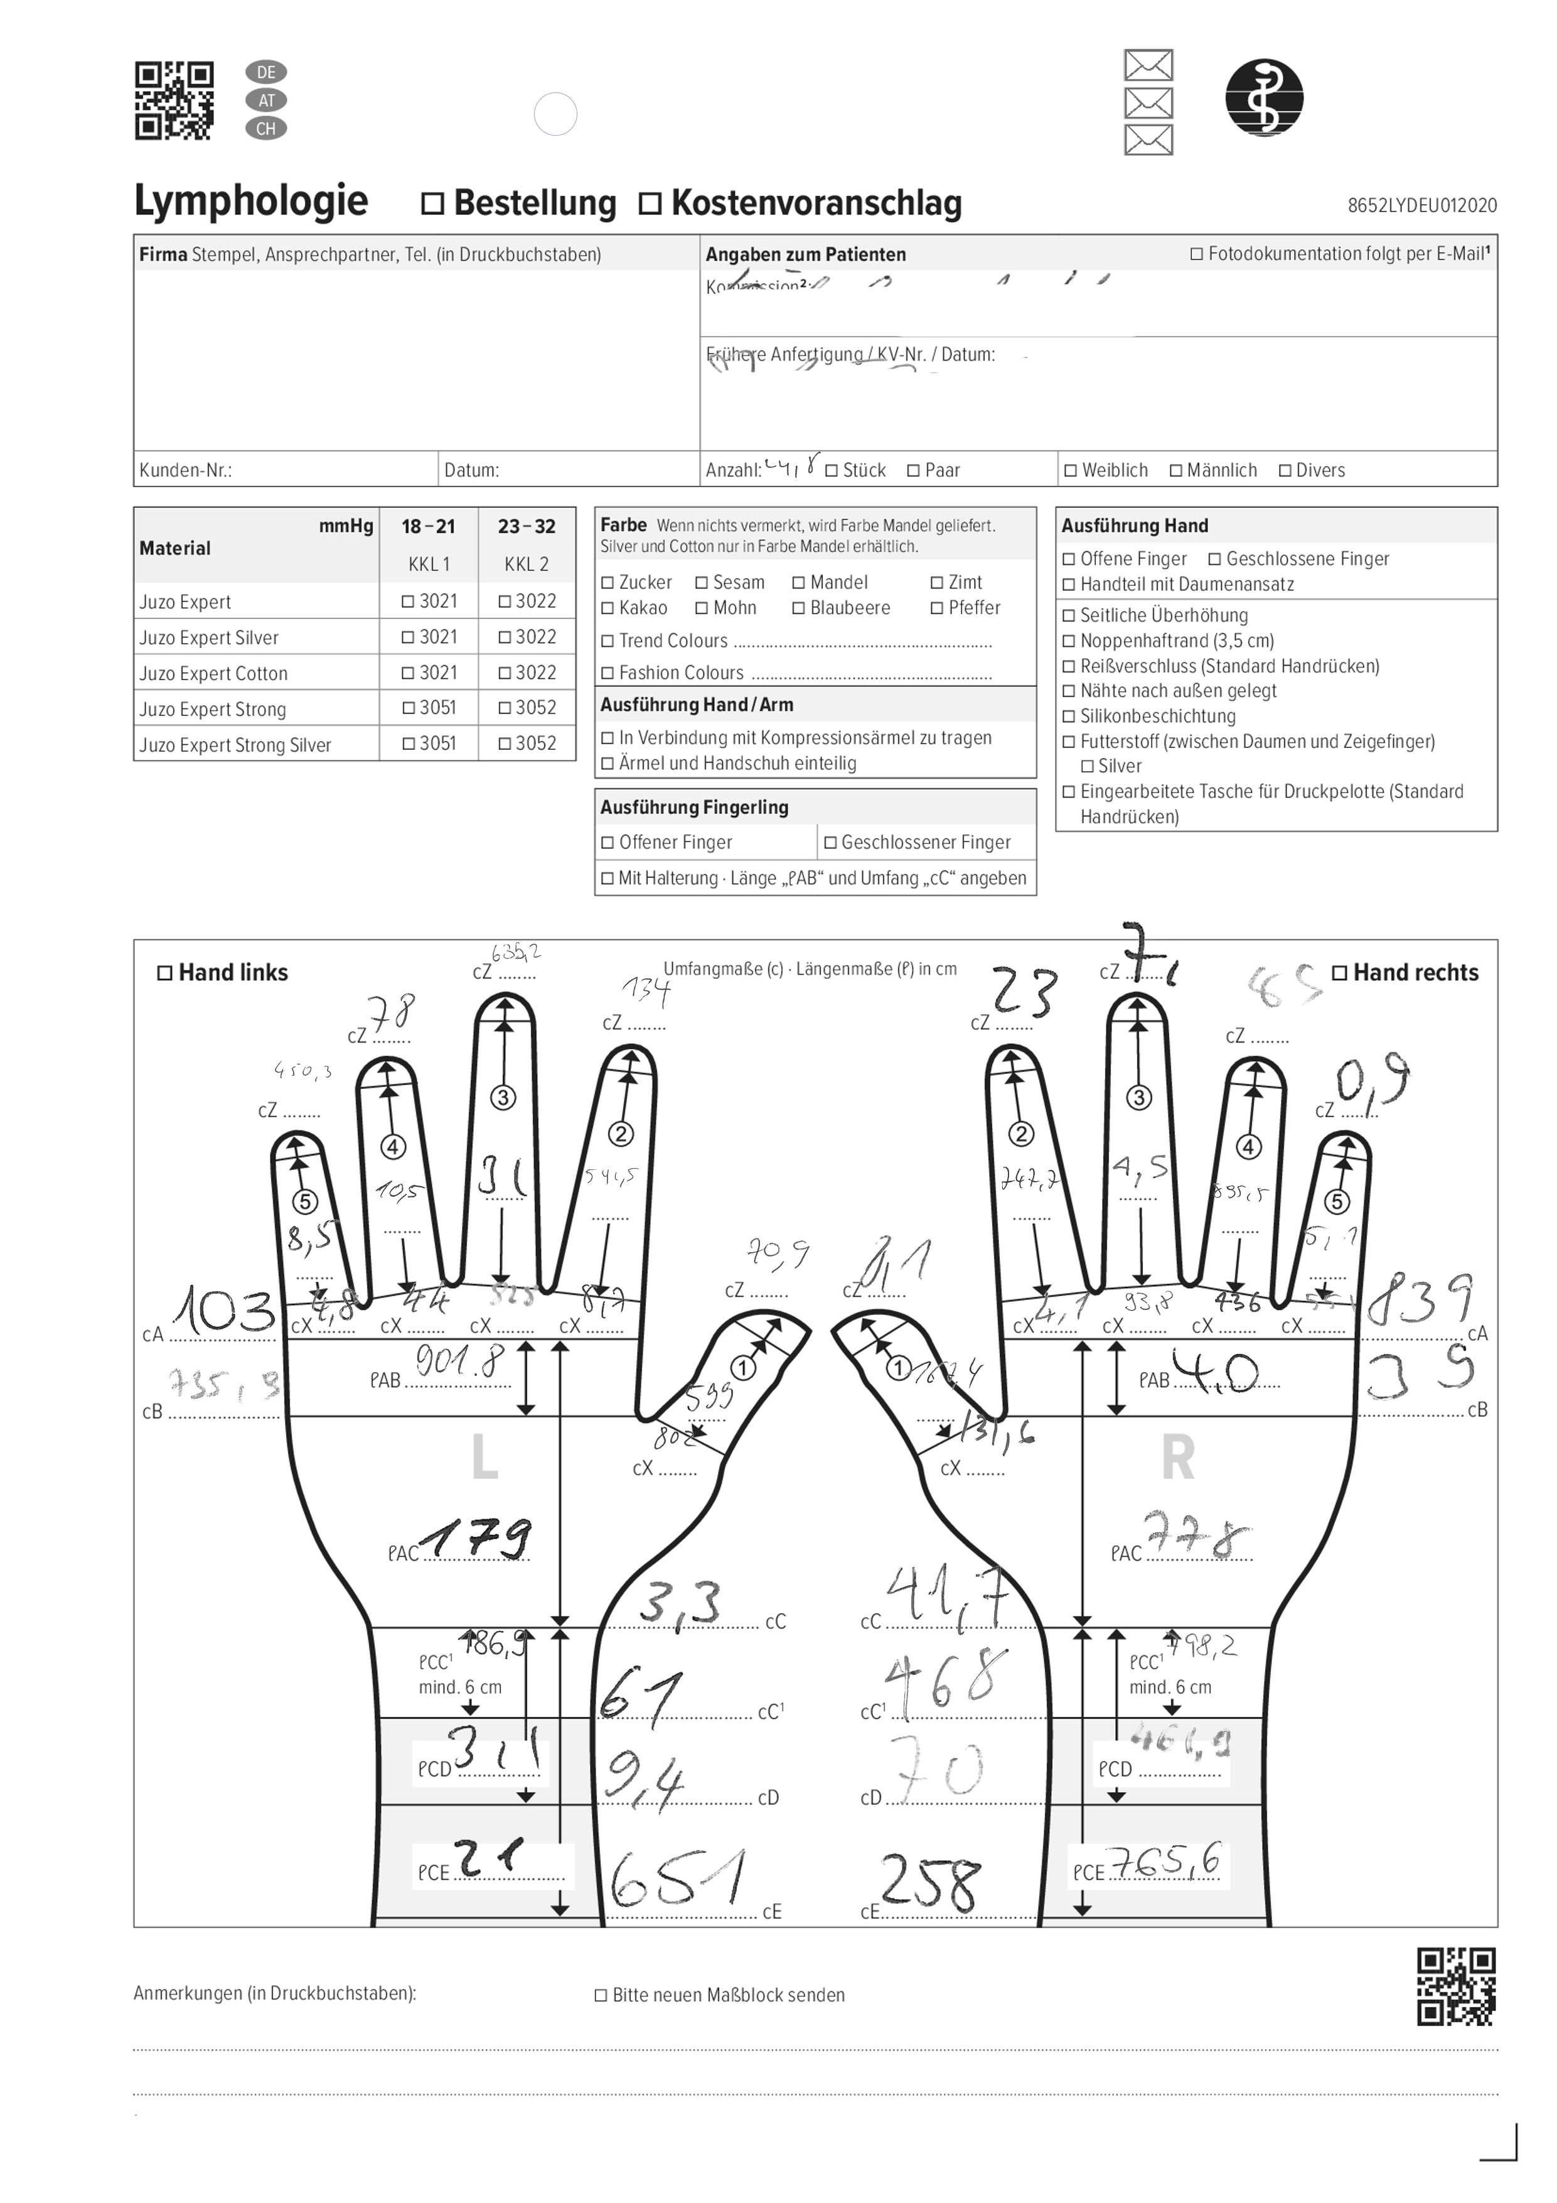
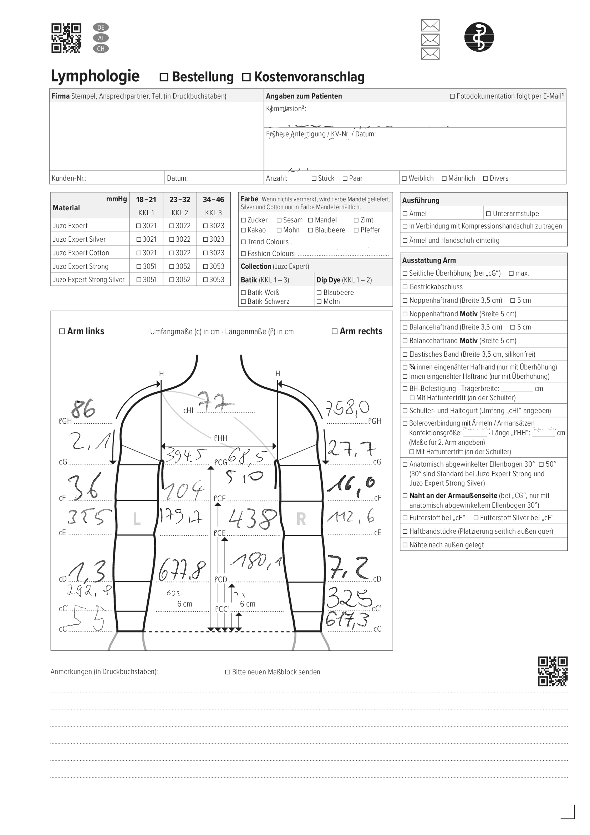
Master Thesis Using Neural Networks for the Domain Adaptation of Synthetic Generated Document Images
Examples of Synthetic Images
DE_LY_Bein_2019-01
DE_LY_Hand_2020-01
DE_LY_Arm_2020-01
Figure: Examples of synthetic images of class Bein, Hand and Arm respectively.

Slide 37
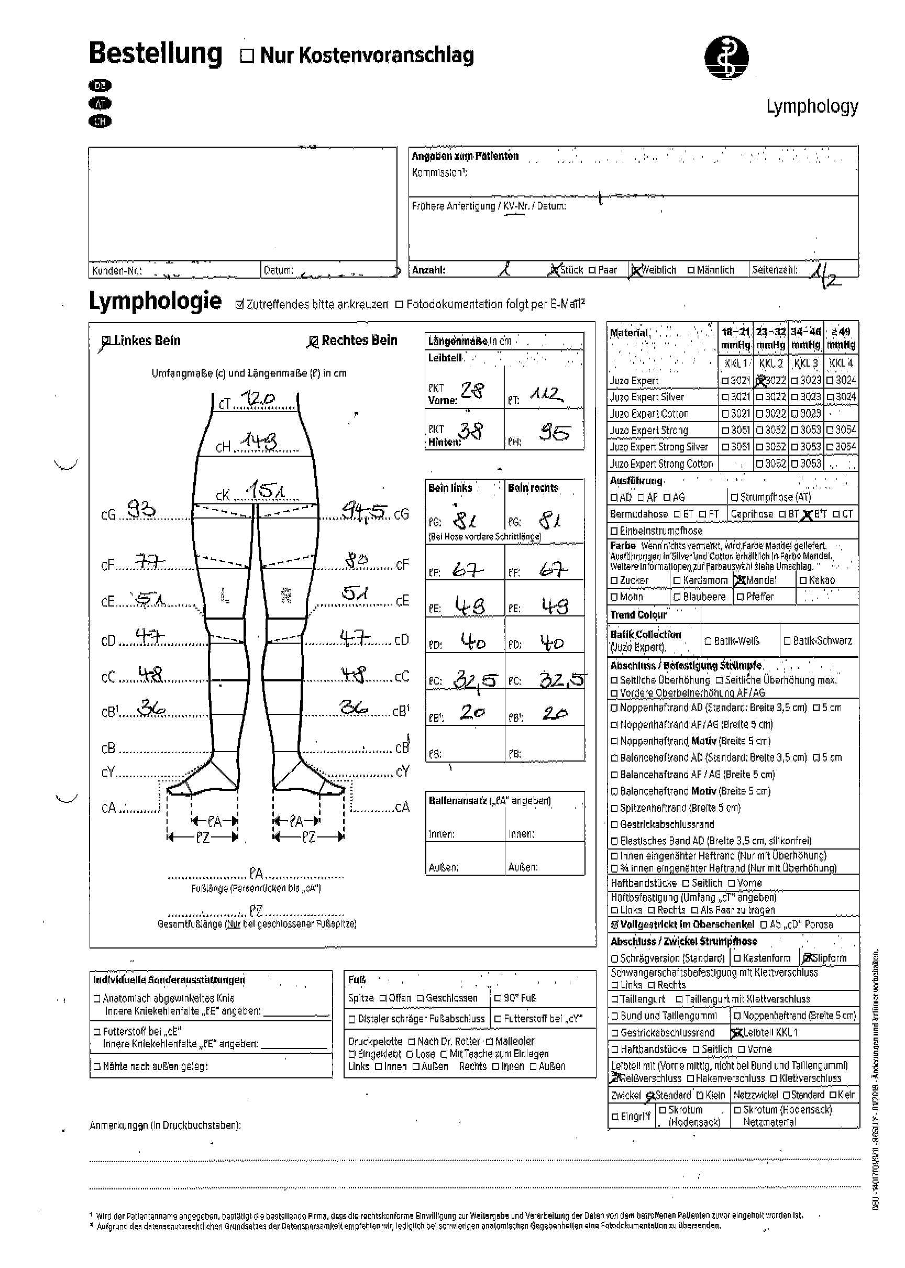
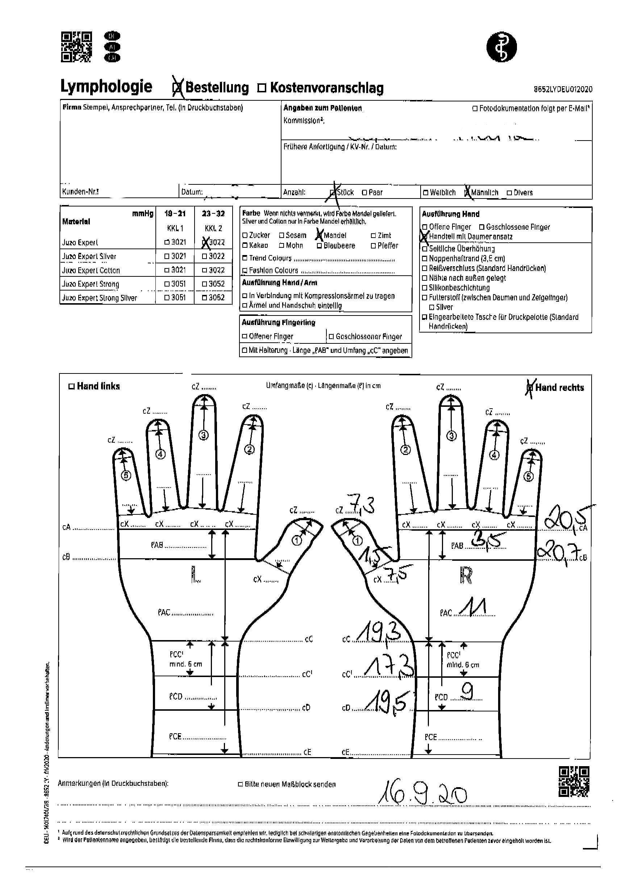
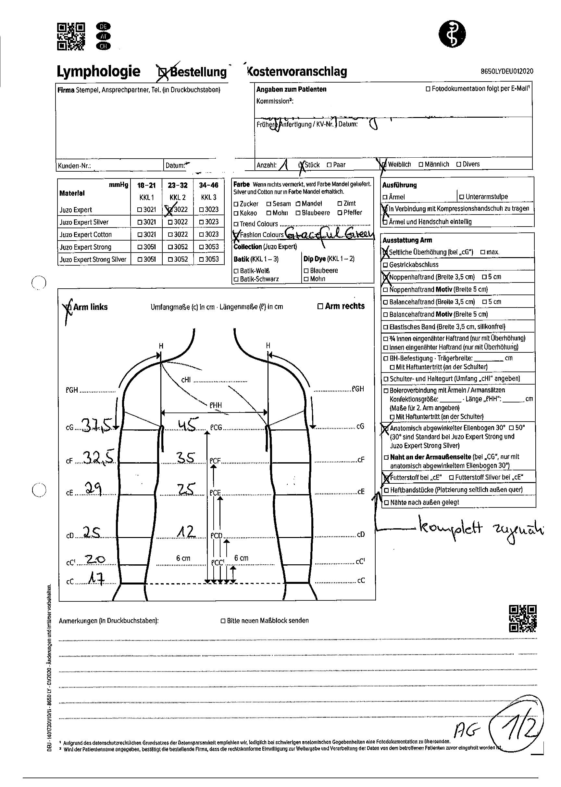
Master Thesis Using Neural Networks for the Domain Adaptation of Synthetic Generated Document Images
Examples of Real Images
DE_LY_Bein_2019-01
DE_LY_Hand_2020-01
DE_LY_Arm_2020-01
Figure: Examples of real images of class Bein, Hand and Arm respectively.

Slide 38
Master Thesis Using Neural Networks for the Domain Adaptation of Synthetic Generated Document Images
Real Images with Major Difference
DE_LY_Bein_2019-01
DE_LY_Hand_2020-01
DE_LY_Arm_2020-01
Figure: Examples of real images with major differences. Images belong to class Bein, Hand and Arm respectively.

Slide 39
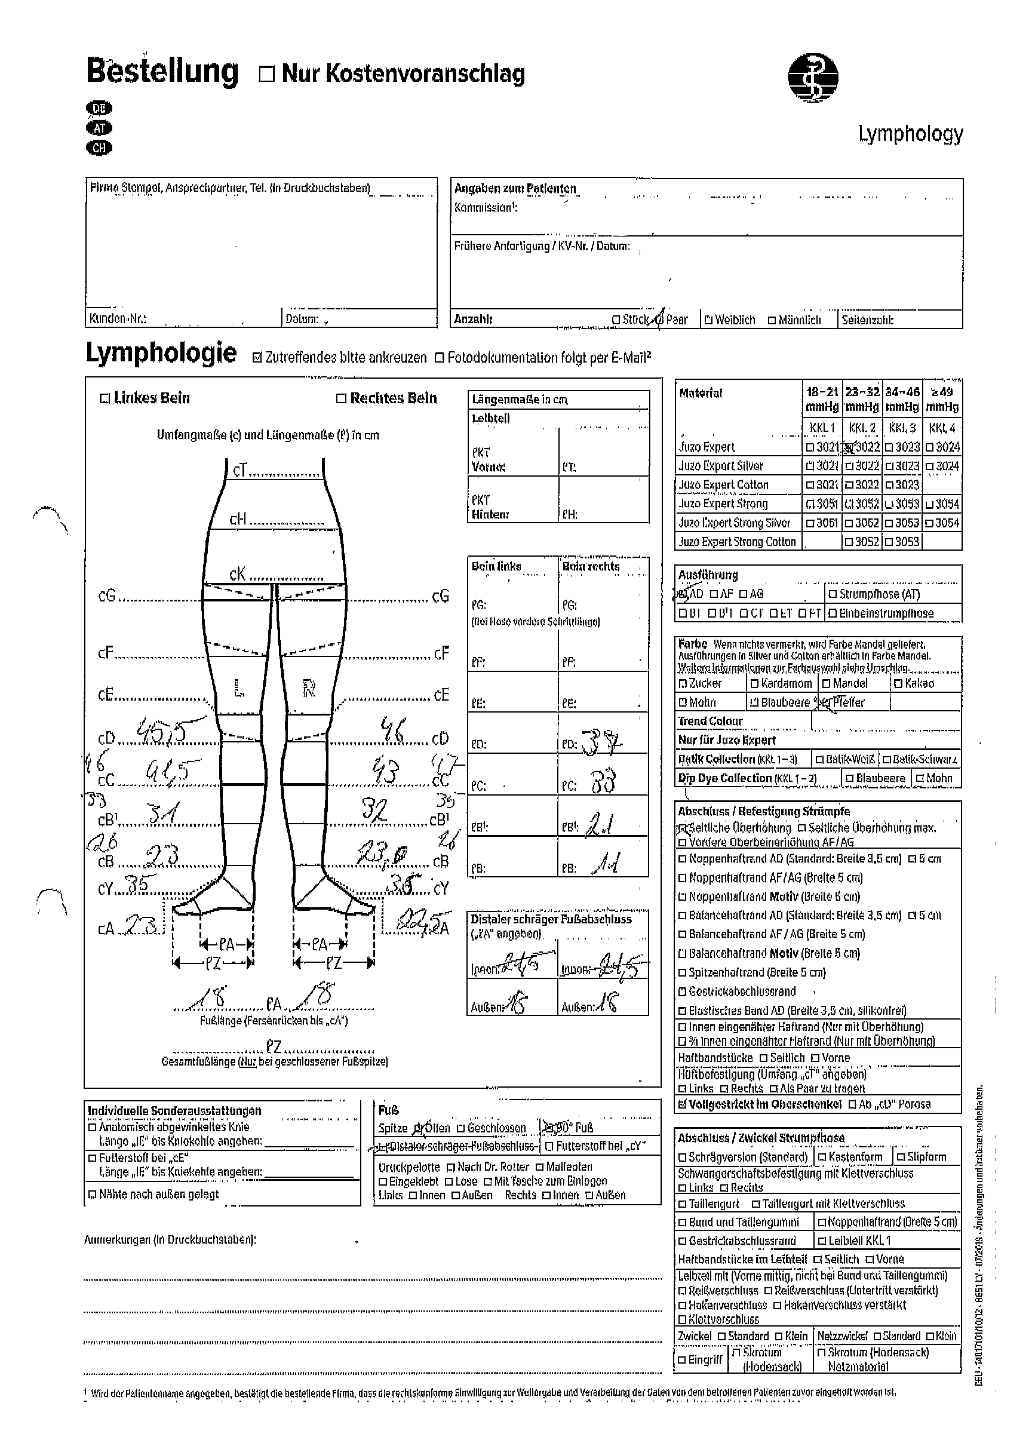
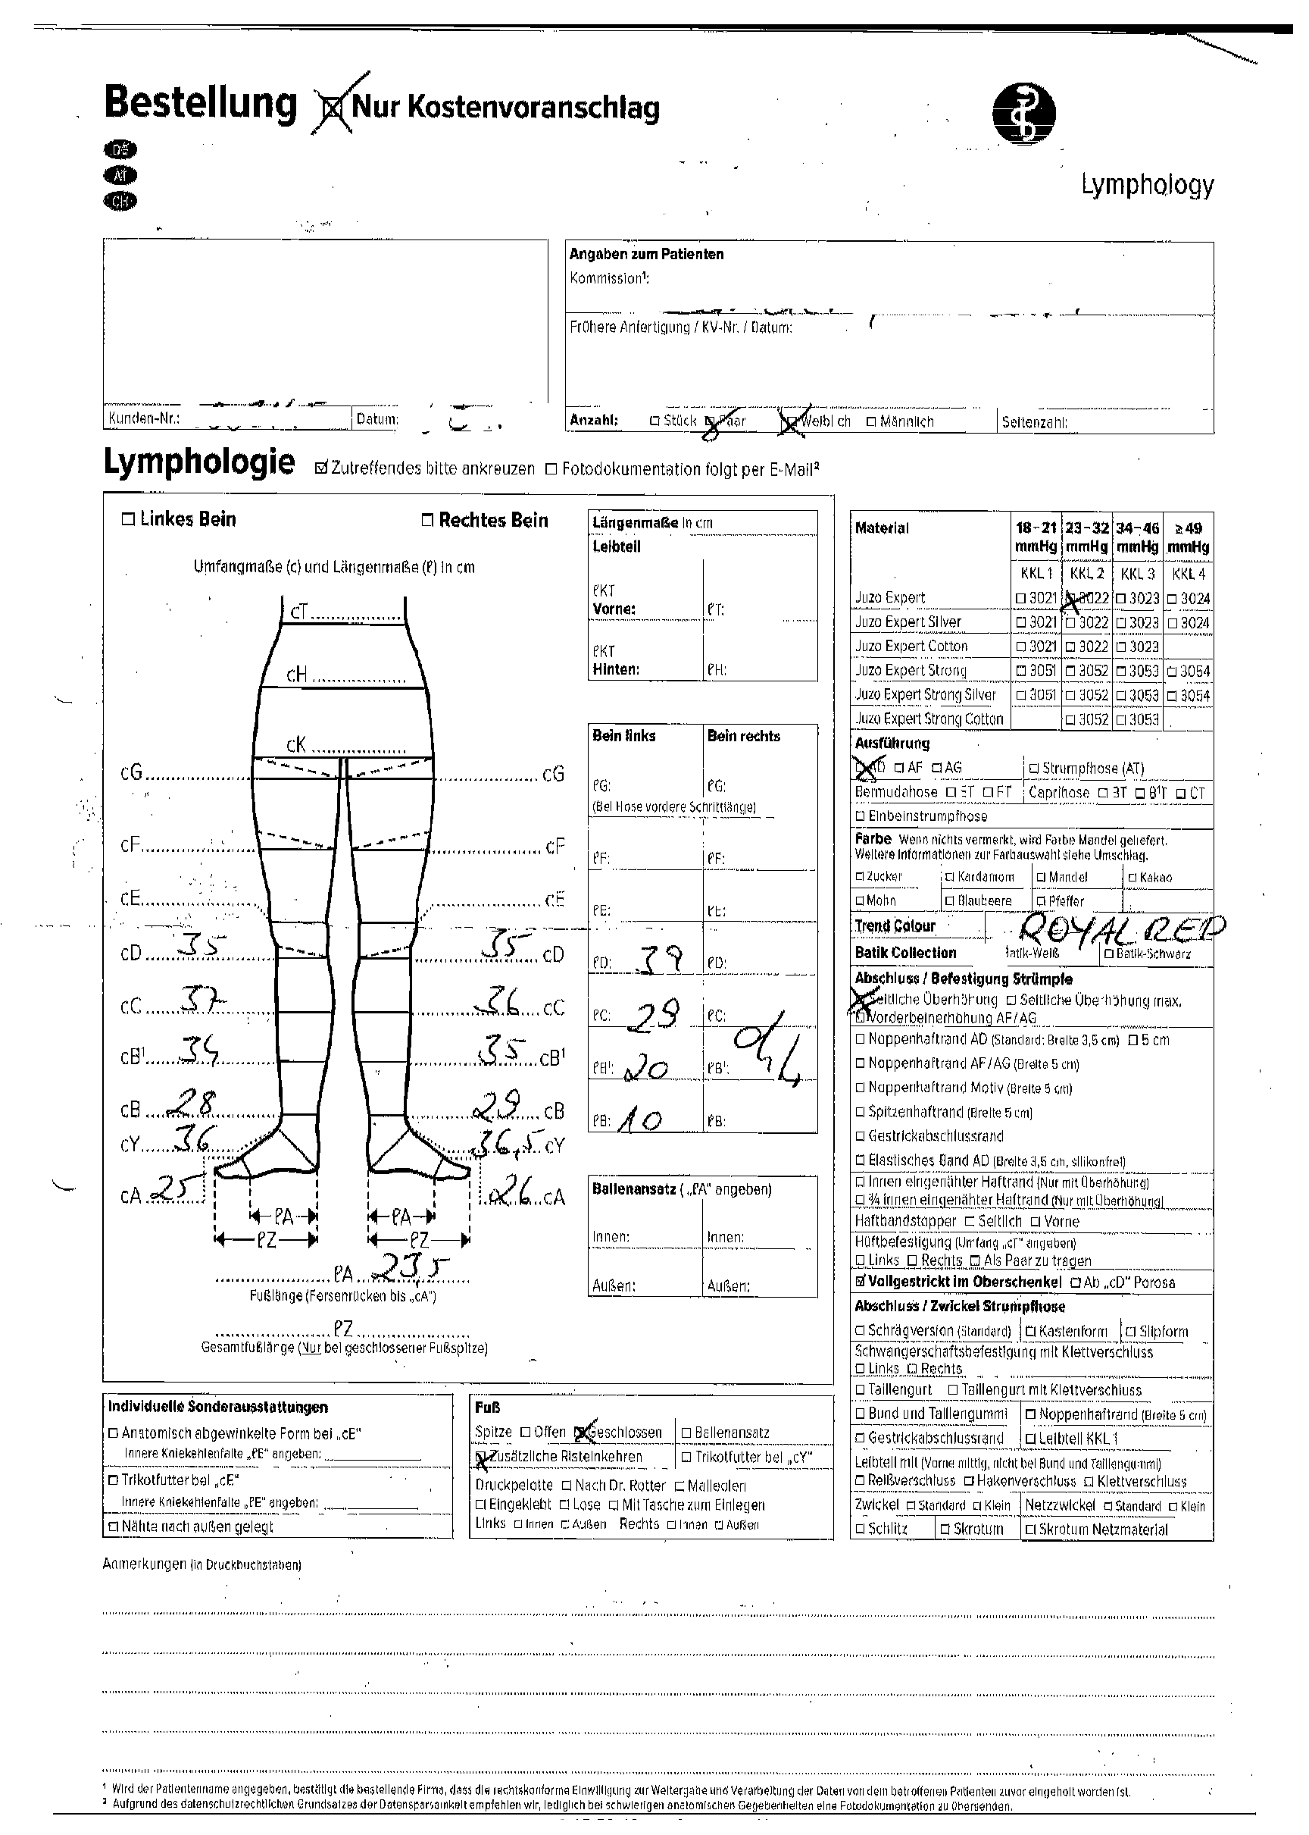
Master Thesis Using Neural Networks for the Domain Adaptation of Synthetic Generated Document Images
Real Images with Minor Difference
DE_LY_Bein_2019-01
DE_LY_Bein_2019-07
DE_LY_Bein_2018-08
Figure: Examples of real images with minor differences. Images belong to class Bein.

Slide 40
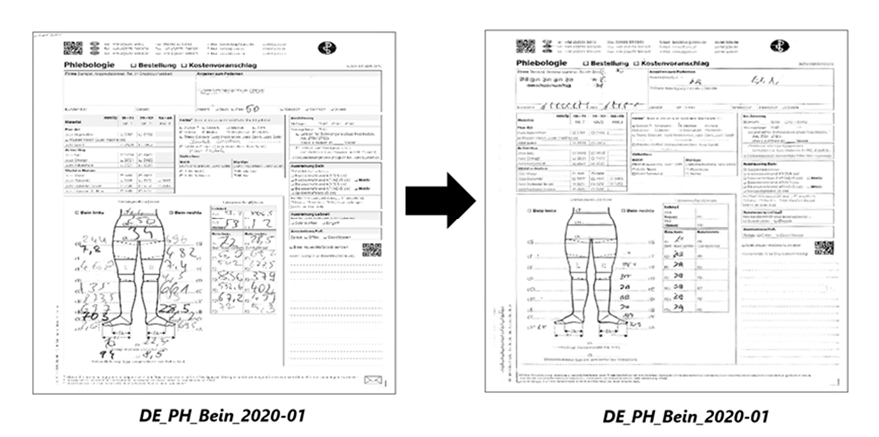
Master Thesis Using Neural Networks for the Domain Adaptation of Synthetic Generated Document Images
Qualitative Results
Synthetic Image
Fake Image
Figure: Qualitative Results.

Slide 41
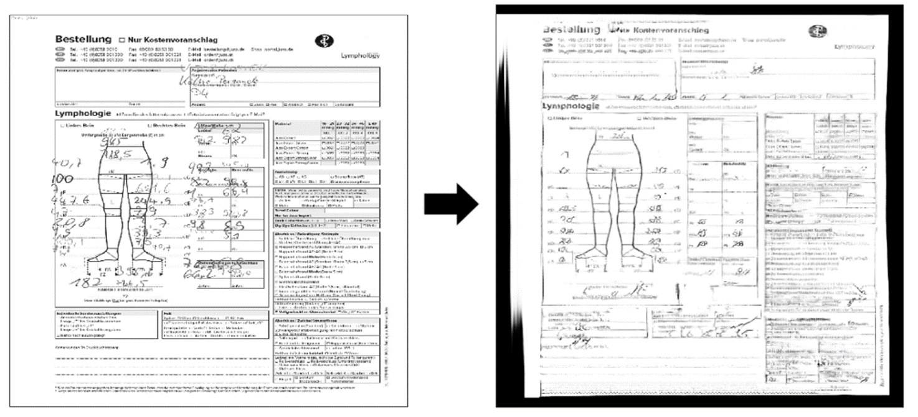
Master Thesis Using Neural Networks for the Domain Adaptation of Synthetic Generated Document Images
Failure Case
Synthetic Image
Fake Image
Figure: The fake image consists of dark border.

Slide 42
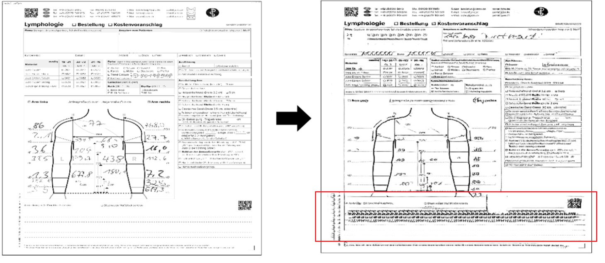
Master Thesis Using Neural Networks for the Domain Adaptation of Synthetic Generated Document Images
Failure Case
Synthetic Image
Fake Image
Figure: The fake image consists of noisy artifacts that are unrealistic.

Slide 43
Master Thesis Using Neural Networks for the Domain Adaptation of Synthetic Generated Document Images
Classifier Architecture
256 x 256 x 1
1 x 10
Flatten Layer
Dense Layer, Softmax
Max Pooling, 2x2, 2
Dropout 0.50
Conv. ReLU 32, 3x3, 1
Dropout 0.25
Dense Layer, ReLU
Conv. ReLU 64, 3x3, 1
Figure: Classifier architecture.

